Slide 1

An Evaluation of Israel's Fiscal Regimes

Slide 2

Study Overview

Slide 3
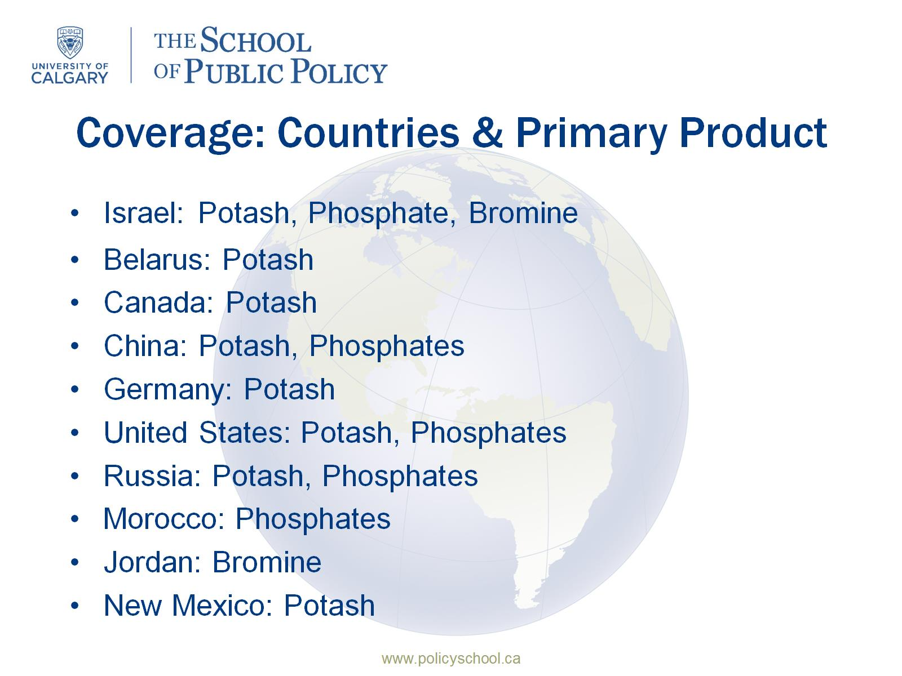
Coverage: Countries & Primary Product

Slide 4
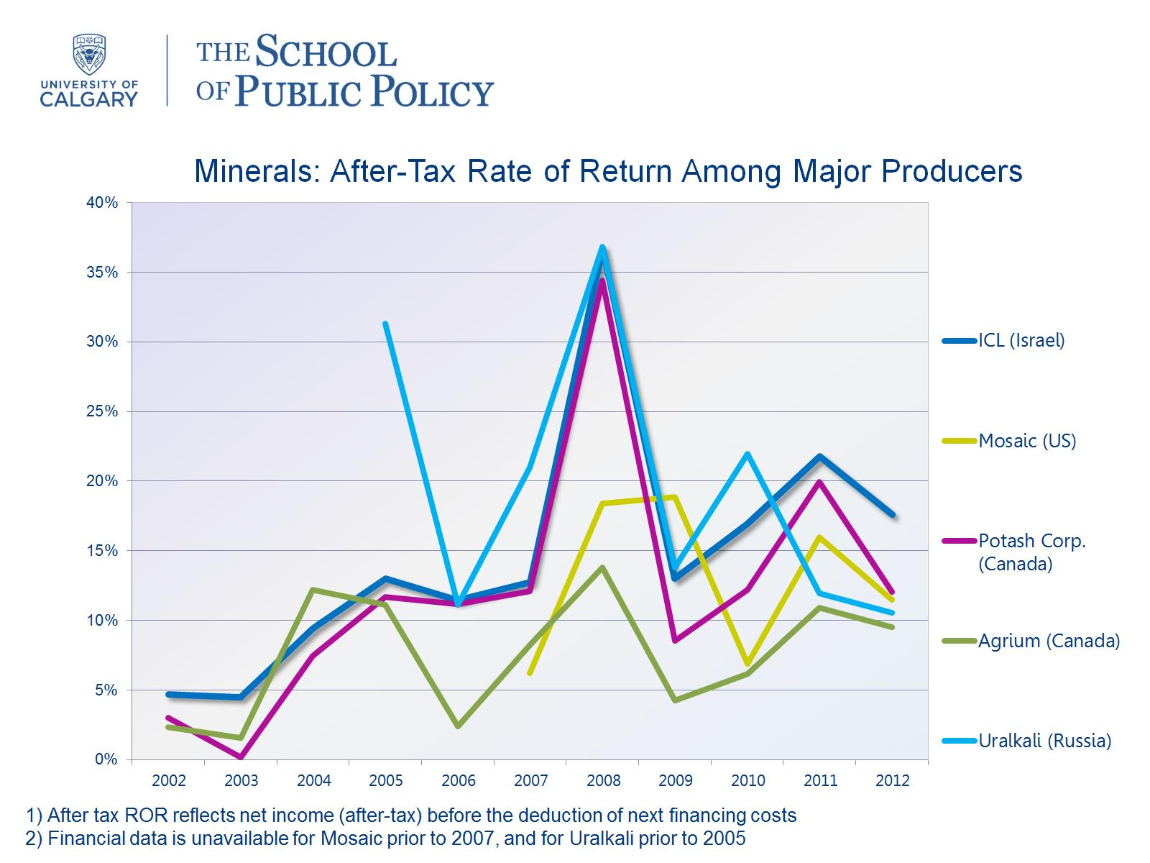

Slide 5

Cash-flow Tax Structure

Slide 6
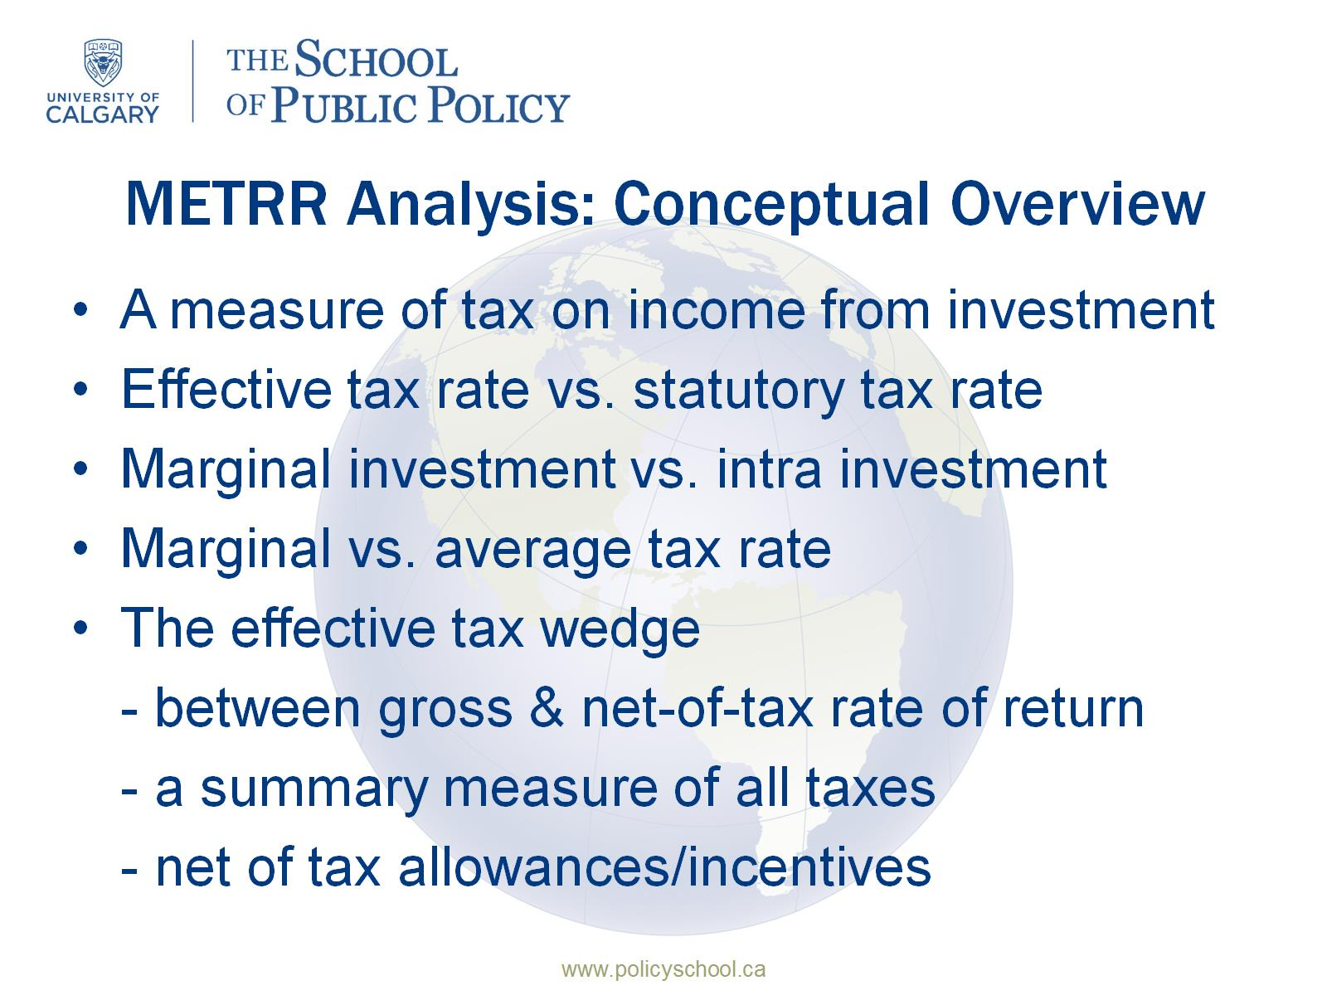
METRR Analysis: Conceptual Overview

Slide 7
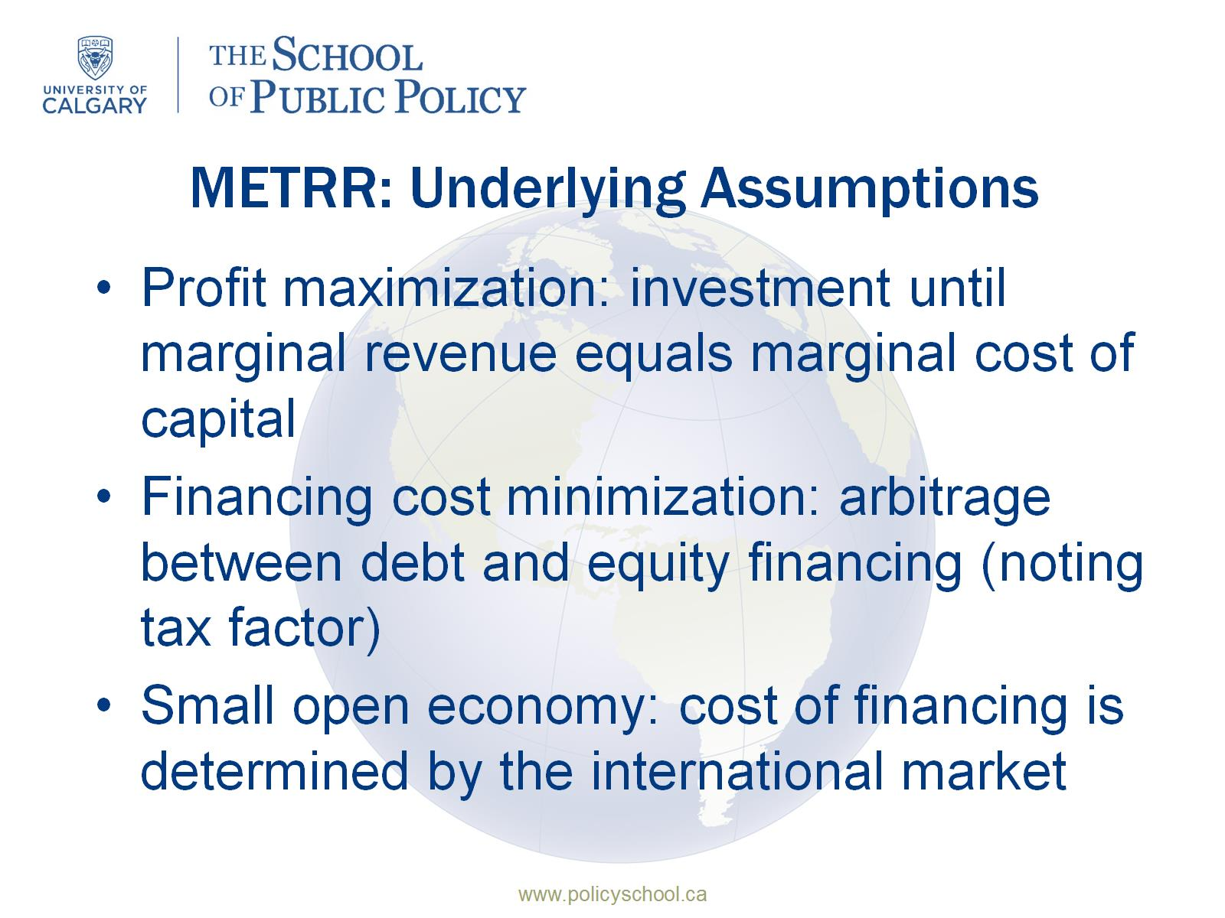
METRR: Underlying Assumptions

Slide 8
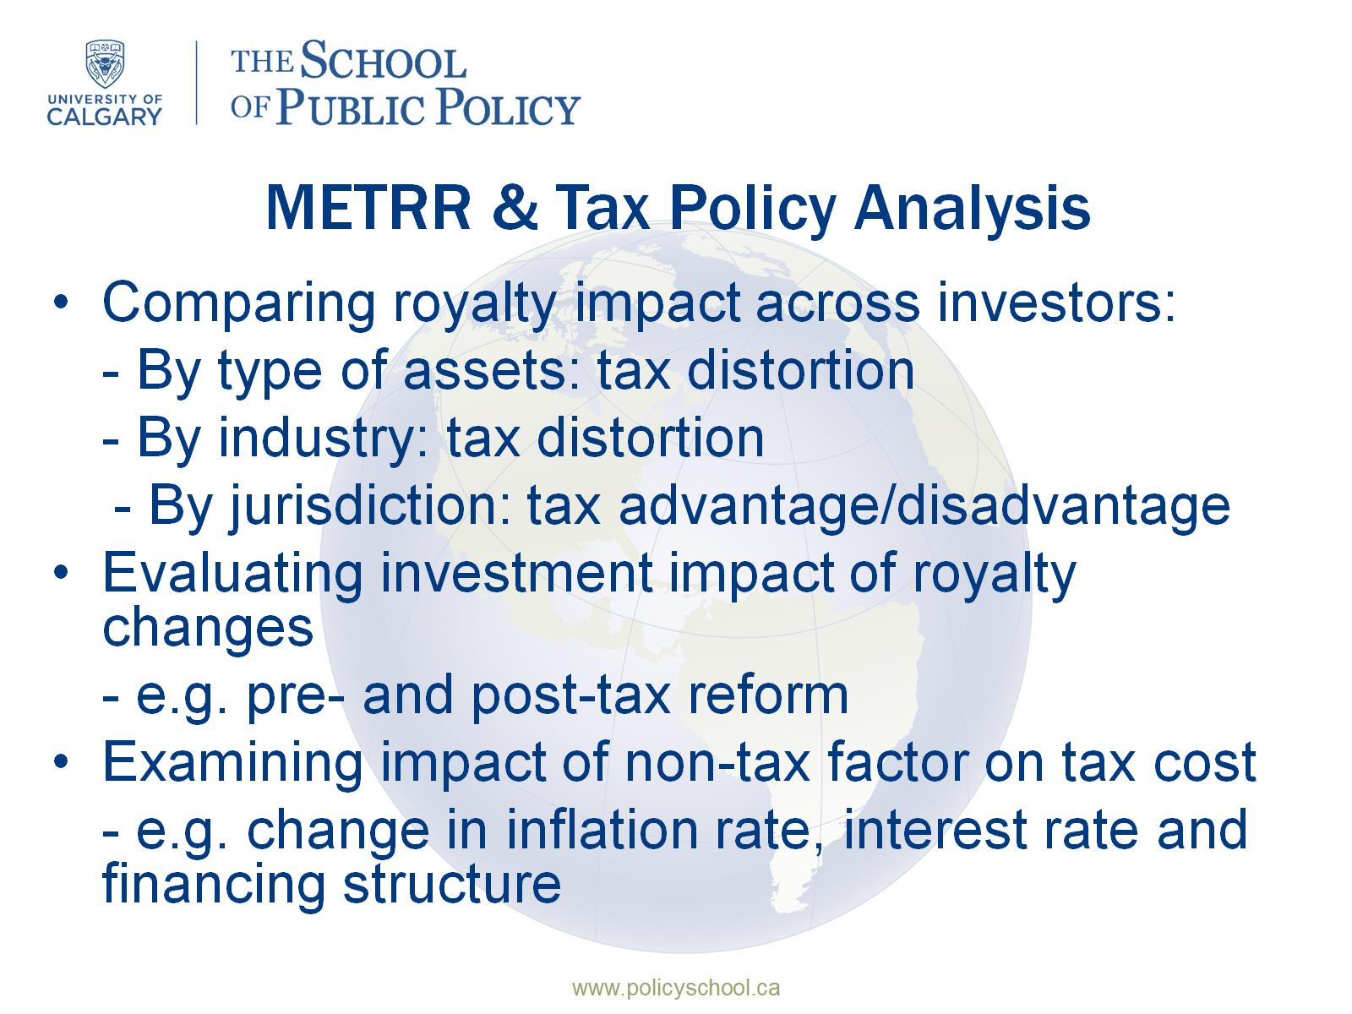
METRR & Tax Policy Analysis

Slide 9
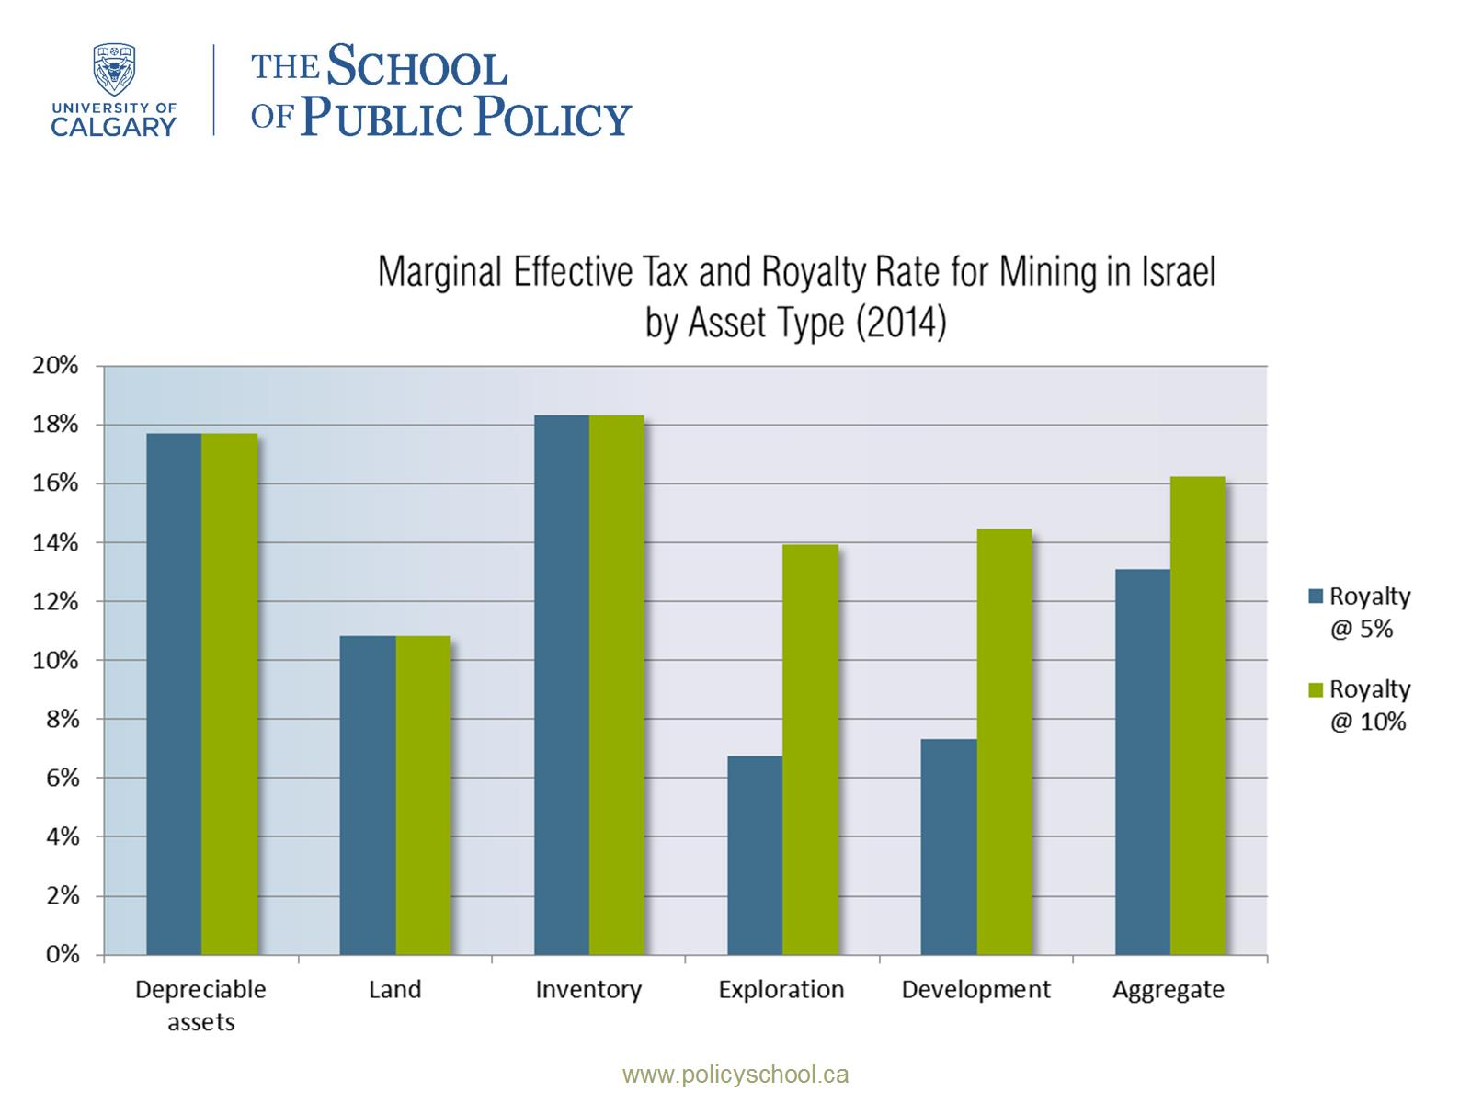

Slide 10
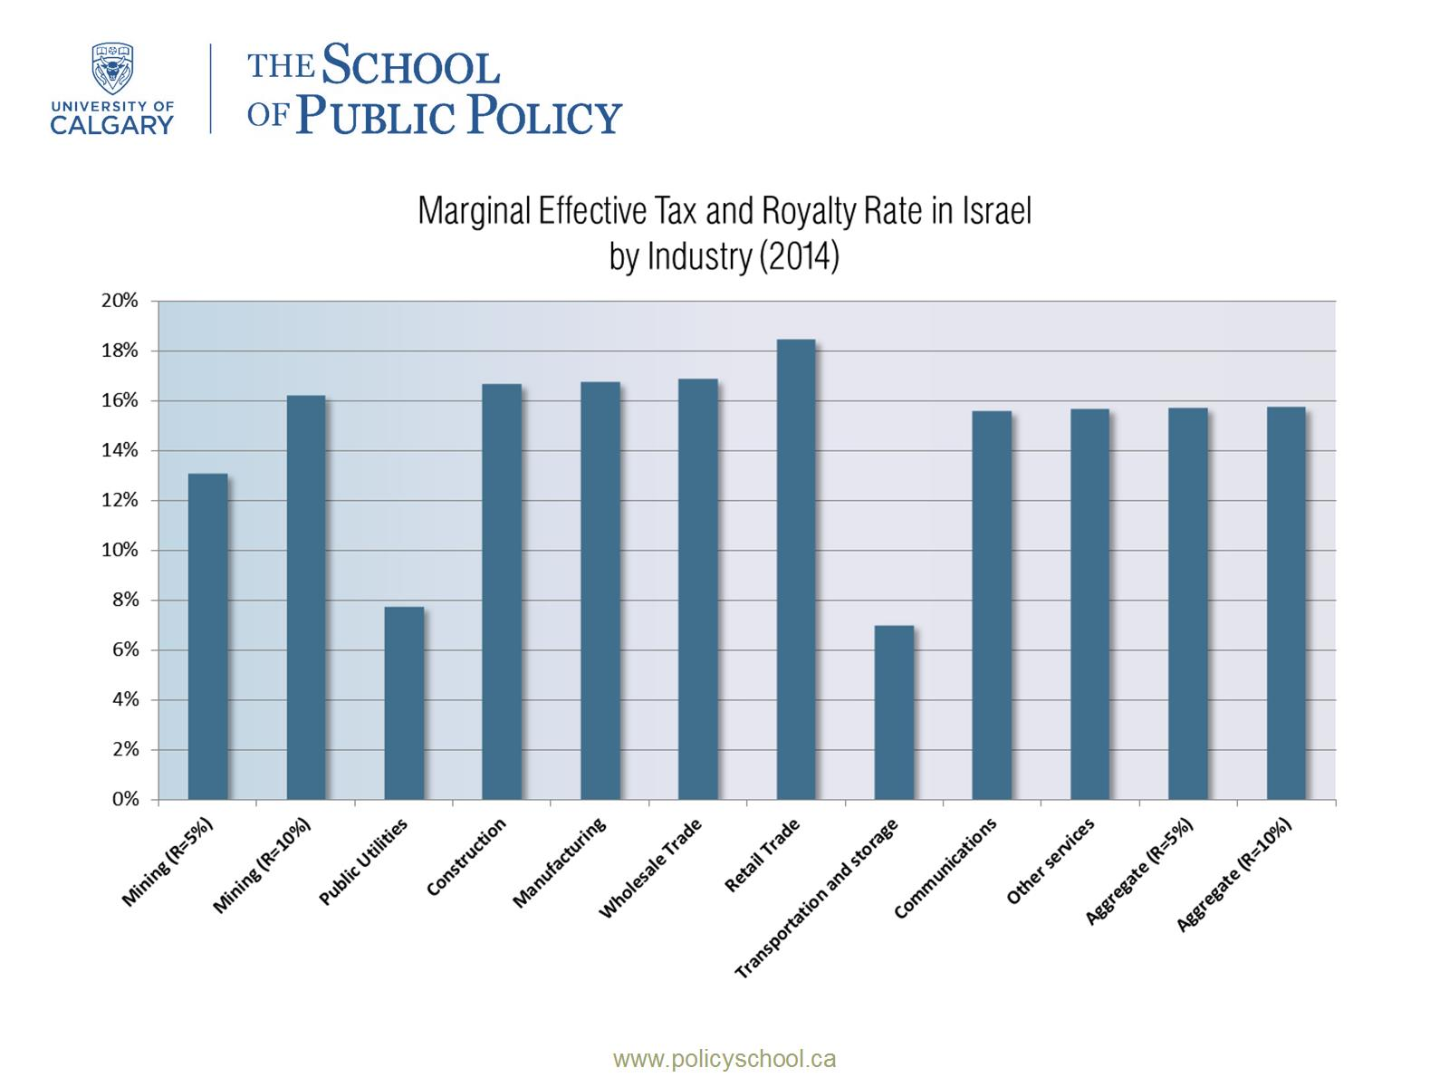

Slide 11
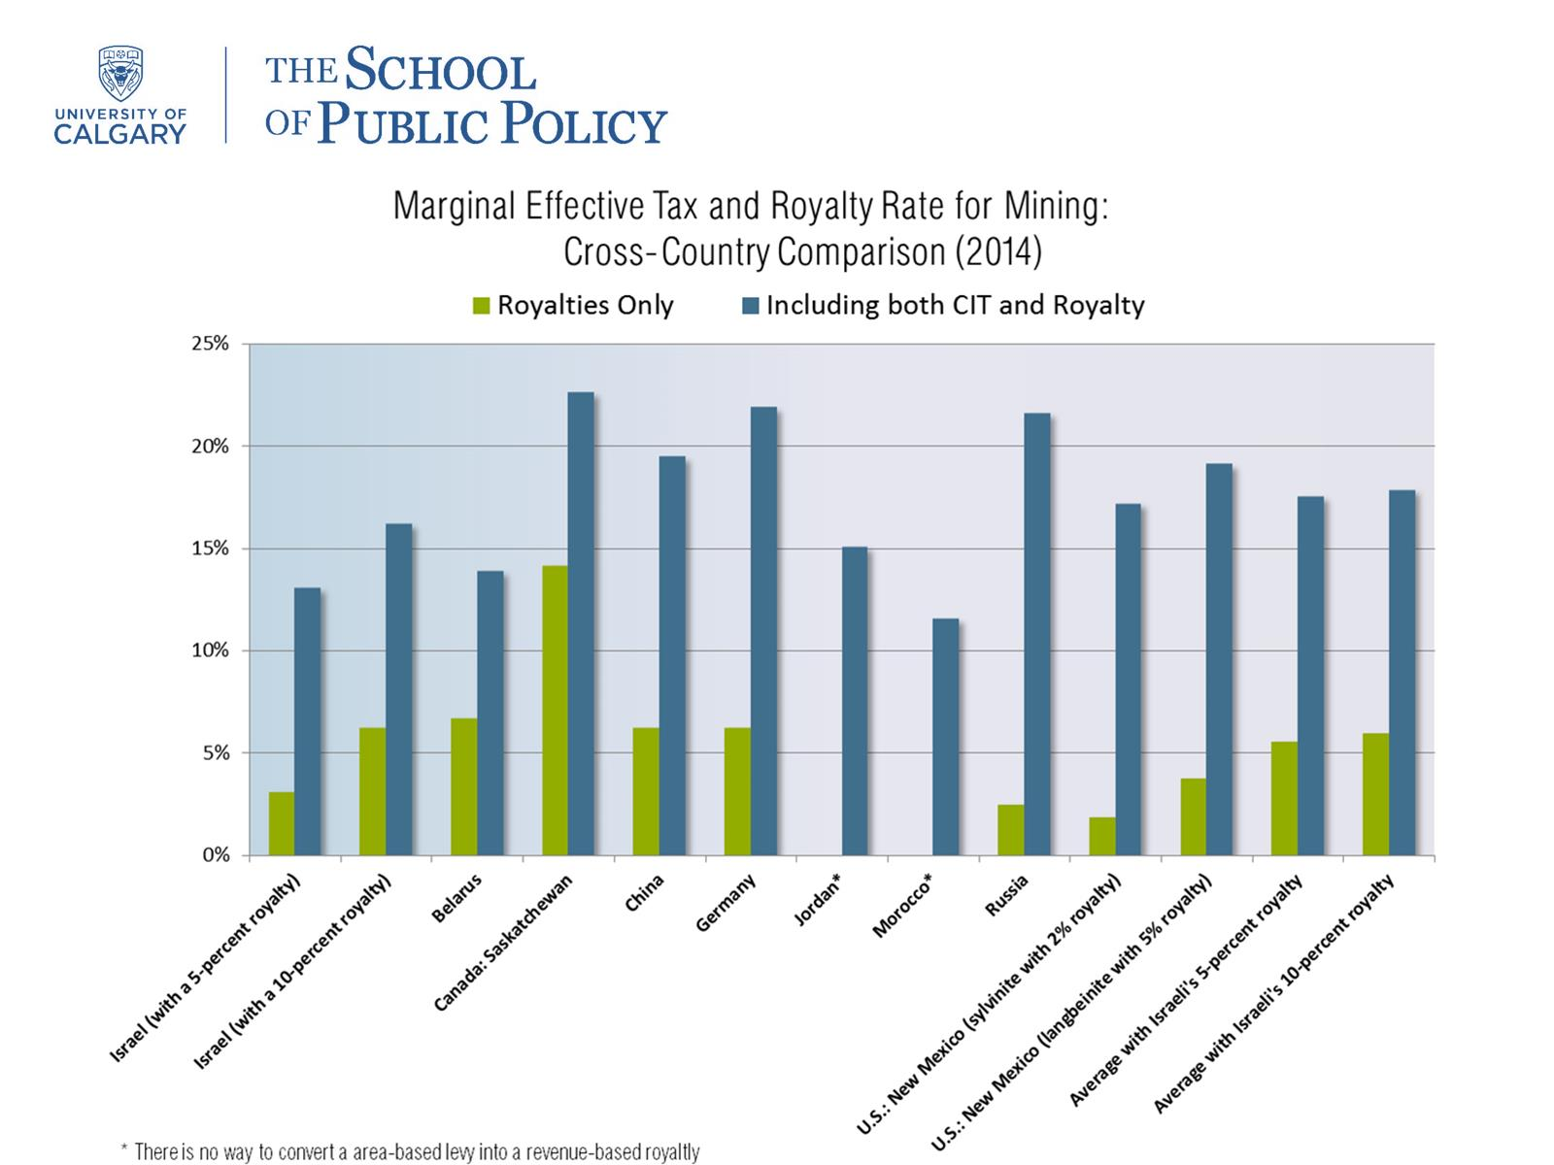

Slide 12
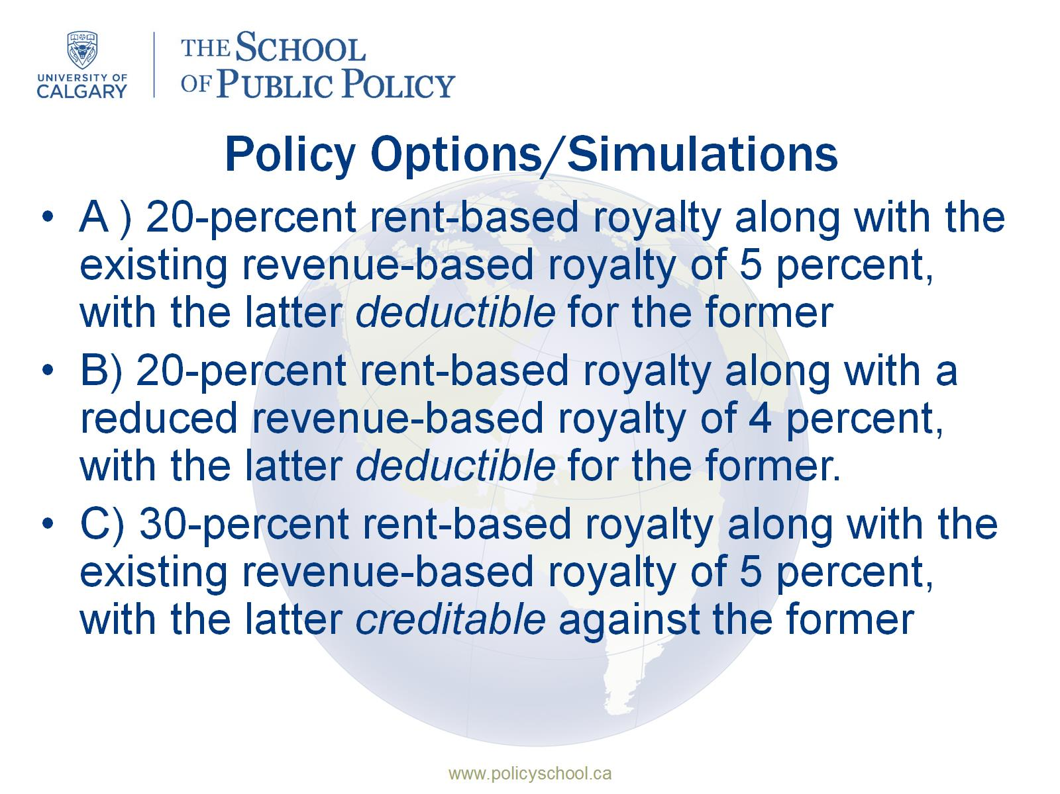
Policy Options/Simulations

Slide 13
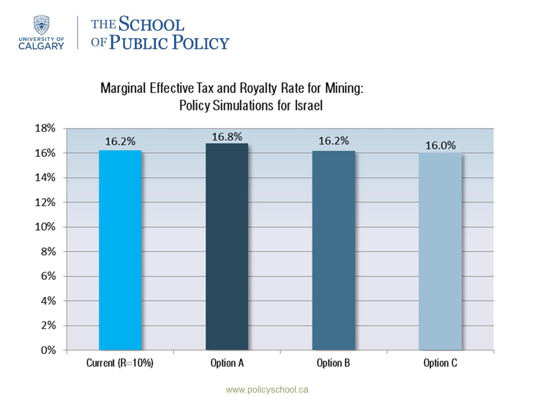

Slide 14

Conclusion & Questions

