Slide 1
Gas Pricing in Israel:
A Preliminary Critique of the Ascari Proposal

Slide 2
Introduction
The following slides comment on an analysis and certain proposals for gas pricing reform carried out by Mr Sergio Ascari, whose presentation was forwarded to IHS by the Israeli Ministry of Energy and Water.
IHS’s comments relate to Mr Sergio Ascari’s proposals for the reform of structural elements of gas pricing in Israel. It is intended that these comments can provide a basis from which Ministry officials can draw their own analysis of the strengths and weaknesses of any new proposals.
These slides do not represent IHS views on what may or may not be desirable for the reform of gas pricing in the Israeli context. Rather, they are intended to highlight the strengths and weaknesses of the results presented in the study undertaken on behalf of the Public Utilities Authority.

Slide 3
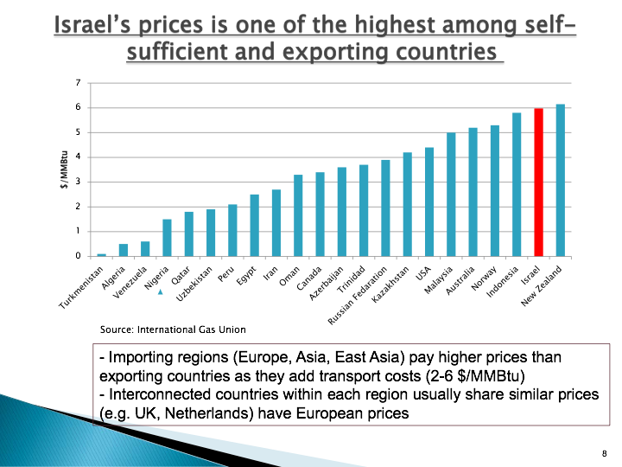
Ascari analysis/proposals
I. Inappropriate international comparisons
Israel’s status is defined incorrectly: as of today Israel imports LNG and does not export any gas; Israel’s potential as a gas exporter depends mainly on the development of the Leviathan field.
This is a poor set of country comparators, clearly chosen artificially to imply that Israel’s gas prices are ‘at the high end’ of international gas prices, which is not true.
The set includes three categories of country that Israel either cannot be or should not want to be compared with:
  Highly distorted/corrupt economies
  Very large exporters with small domestic gas markets (Qatar, Oman, Trinidad, Norway …)
  Highly diverse, mature gas markets with massive low cost production (USA, Russia … )
A more appropriate set should include countries like Denmark, the UK and the Netherlands along with reasonable comparators shown here such as Malaysia and New Zealand
Ascari, Slide 8

Slide 4
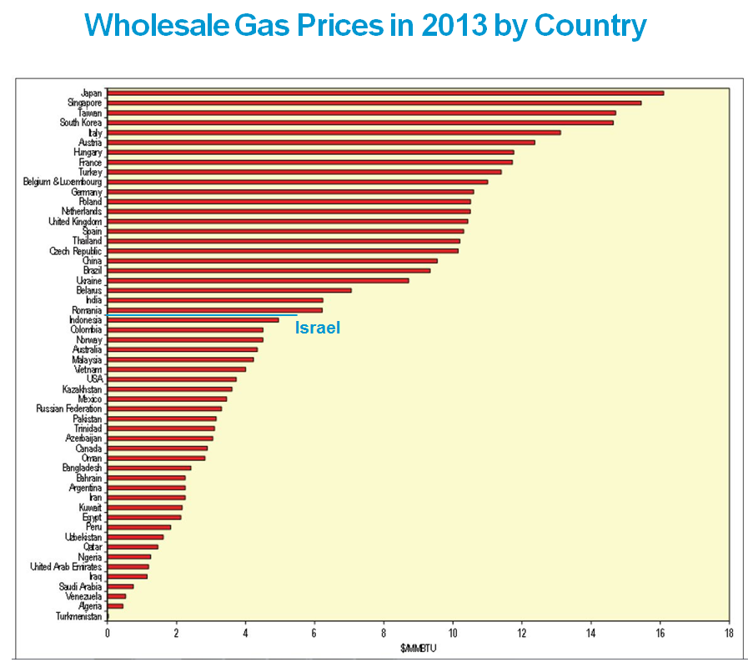
Ascari analysis/proposals
II. Inappropriate price reference points
The average wholesale gas price in Israel is approximately $5.7 /mmbtu.
This datum point is plotted against equivalent average wholesale prices for a wide range of other jurisdictions (see graph)
It is apparent that the average prices for the selected jurisdictions used in Ascari slide 8 present a distorted picture of the real situation.
Source: IGU Report 2013

Slide 5
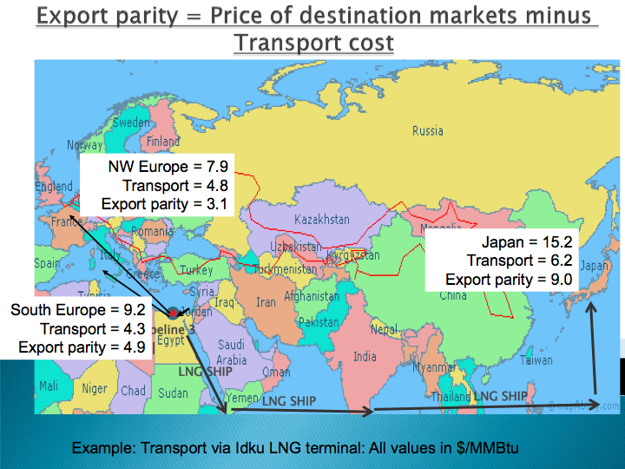
Ascari analysis/proposals
III. Imprecision in ‘Export Parity’ calculation
The ‘export parity’ proposal is a brave effort at finding an ‘objective’ basis for gas pricing
But it cannot work:
  The calculation of transport cost—central to the assessment—needs several, arbitrary, assumptions
  For example, LNG shipping costs—On a fully-built up cost basis? Or a marginal cost basis? (This will depend on whether LNG ships are in shortage or surplus on world markets, which will change from time to time). If fully-built up, then at what discount rate/return on capital? At what debt-equity basis? And for whose tax status?
  Similar assumptions have to be made for liquefaction and regasification elements in the transport chain, or, mutatis mutandis, for a pipeline costs, and for hypothetical, not-yet-built pipelines.
Ascari, Slide 15

Slide 6
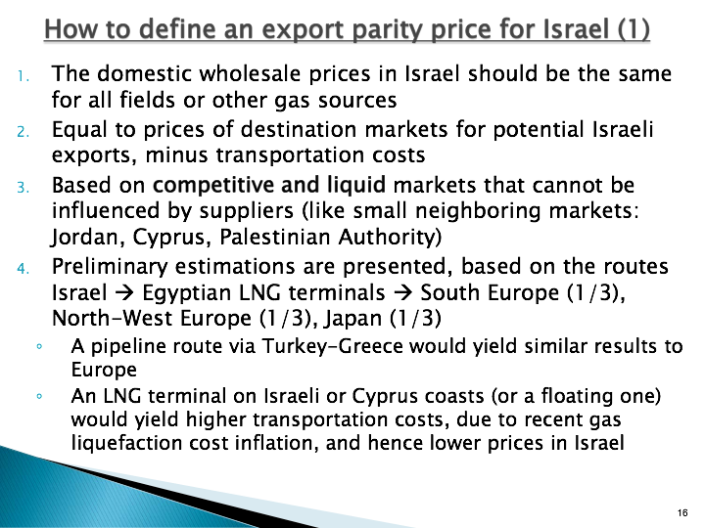
Ascari analysis/proposals
IV. Further problems with ‘Export Parity’ calculation
Point 1 may be acceptable, although debatable as a matter of public policy; while point 3 is both acceptable and admirable in principle
But point 2 -‘minus transportation costs’ -opens up endless argument and inaccuracies
Point 4 admits that these estimations are preliminary—they are destined to remain always preliminary and imprecise, and therefore contractually unworkable.
Point 3 — keeping the gas price out the influence of third parties—is important
Most gas contract terms extend this principle to making sure the price is also outside the influence of the parties to the contract:
  Either by reference to a liquid traded gas market
  Or by reference to other fuels, combined with specific renegotiation and other risk-management provisions
Ascari, Slide 16

Slide 7

Political Risk Ranking – Q3 2014, Israel, Middle East, Egypt and Cyprus (part of the overall E&P ranking)
Rank | Country | Political
 |  | Overall Rating (100%) | Political (60%) | Socio-Economic (20%) | Commercial (20%)
1 | Qatar | 0.45 | 0.26 | 0.38 | 1.12
2 | United Arab Emirates | 0.51 | 0.42 | 0.25 | 1.05
18 | Saudi Arabia | 1.18 | 1.11 | 0.63 | 1.96
20 | Oman | 1.21 | 0.90 | 0.83 | 2.56
31 | Kuwait | 1.48 | 1.28 | 0.98 | 2.60
43 | Cyprus | 1.71 | 1.24 | 2.75 | 2.08
54 | Iran, Islamic Republic of | 1.87 | 1.64 | 0.98 | 3.47
60 | Israel | 1.99 | 1.92 | 2.18 | 1.99
61 | Bahrain | 1.99 | 2.30 | 1.40 | 1.67
71 | Jordan | 2.11 | 2.14 | 2.55 | 1.60
80 | Egypt | 2.23 | 2.02 | 1.75 | 3.34
115 | Lebanon | 2.91 | 3.10 | 2.93 | 2.33
117 | Iraq | 3.15 | 3.69 | 1.88 | 2.80
123 | Syrian Arab Republic | 3.34 | 3.34 | 3.18 | 3.49
124 | Yemen | 3.35 | 4.07 | 1.78 | 2.77
When political country risk is ranked independently, Israel ranks in the middle of the peer group countries from the Middle East and region.
Regional foreign policy issues continue to loom large. There is no formal government opposition to foreign investment in Israel; indeed quite the opposite is true. But it appears that softer, non-governmental constraints on foreign investment may exist for Israel, including the perceived threat of war on neighboring territory or the broader Middle East region, as well as the threat of internal violence (terrorism).
Israel’s less-than-mature E&P regulatory regime has also been cause for unanticipated regulatory risks, as illustrated by the debate within the government over gas exports and gas price regulation, and by the Anti-Trust Authority’s recent announcement (Q4 2014) that it is considering designating the Noble and Delek partnership in the Leviathan field as an illegal cartel. This is an unexpected reversal of the Authority’s proposed agreement with Noble and Delek earlier this year, which followed two years of negotiations and would have allowed the companies to maintain majority stakes in Tamar and Leviathan.
A further factor for consideration, and one which is not treated explicitly within the ranking methodology used to generate the above table, is the E&P investor community’s perception that doing business in Israel might impact their opportunities to invest in Arab countries.
Source: IHS Connect, Petroleum Economics and Policy Solutions Database

