Slide 1
Fiscal incentives for Marginal Fields
April 3rd, 2015
Jim Thomas, Vice President Regulatory & Compliance
Ulya Abdullayeva, Director Upstream Oil & Gas Consulting
Steve Parish, Senior Principal Economist
Tania Pearson, Principal Economist
Laura Sima, Consultant Upstream Oil & Gas Consulting

Slide 2
Content
Objectives
Approach
Executive summary
Analysis by country
Appendix

Slide 3
Objectives
Israeli Petroleum Commissioner would like to assess ways to ensuring that two small offshore Israeli gas discoveries (Karish and Tanin) are developed.
Petroleum Commissioner has approached IHS to understand how different countries incentivize smaller or marginal field development and how these best practices could be applied to the Israeli fields.
IHS proposes to carry out the work in two Phases:
  Phase 1: Benchmarking of Petroleum Fiscal Regimes and international best practices applicable to marginal field development.
  Phase 2: Economic analysis of Karish and Tanin fields and recommendation for amendments to the fiscal regime applicable to these fields.
This presentation focuses on Phase 1.

Slide 4
Content
Objectives
Approach
Executive summary
Analysis by country
Appendix

Slide 5
Approach (1/2)
The key source for this study is IHS in-house database PEPS (Petroleum Economics and Policy Solutions). The database contains an extensive list of regulatory documents such as laws, contracts, bid round information issued by Governments and Ministries around the world, which are analysed by IHS experts. Fiscal terms presented in this analysis are extracted from these documents.
In this report, IHS provides the following:
  QUALITATIVE ANALYSIS: A summary and general overview of the fiscal incentives offered for marginal acreage.
    Where available, the evolution in time of these terms has also been reflected.
    Other incentives such as infrastructure, export duty, special terms for gas or offshore/ deep water etc. have been provided if considered relevant for Israel.
  QUANTITATIVE ANALYSIS (Illustrative comparison): Where information is available, IHS also provides indicative Investor IRR and Undiscounted State Take for hypothetical gas projects in a given country calculated under the generally applicable fiscal terms and the special terms for marginal fields. This is done in order to compare impact of special terms for marginal fields on the fields’ economics in a given country.
    The economic indicators are provided for two hypothetical gas fields of 600 bcf and 1.5 tcf – as field sizes similar to Tanin and Karish.
    The generally applicable fiscal terms are those that IHS understands are currently offered in the selected countries, and where available – specifically for offshore.
    For the methodology used to calculate these economic indicators, please refer to the Appendix.

Slide 6
Approach (2/2)
Interrogation of the PEPS database revealed that several countries currently offer special terms for marginal fields.
However, the availability of the information on specific terms for marginal fields varies from one country to another:
  In some countries such special terms are clearly stipulated in the legislation and/or in the issued Model Contracts.
  While in others, there is merely a mention that special terms may apply to marginal fields and such terms are subject to a negotiation with the investor companies.
  In some cases, IHS is aware that special terms apply, however, the data is not publicly available and hence not reflected in this report.
Therefore, the level of analysis on the countries that offer special terms for marginal fields, as presented in this report, can be grouped as follows:
Qualitative and quantitative analysis
Qualitative analysis
Limited qualitative analysis
Not covered in this report
  Netherlands
  Nigeria
  Norway
  Pakistan
  Peru
  Yemen
  UK
  Albania
  Denmark
  Malaysia
  Malta
  Russia
  Thailand
  Angola
  Cameroon
  Colombia
  Indonesia
  Trinidad & Tobago
  Argentina
  Bangladesh
  Ecuador
  Ireland
  Italy

Slide 7
Content
Objectives
Approach
Executive summary
Analysis by country
Appendix

Slide 8
This report analyzes special terms for marginal fields offered worldwide
Norway
Denmark
Russia
UK
Netherlands
Malta
.
Albania
Pakistan
Yemen
Thailand
Nigeria
Malaysia
Peru
Source: IHS PEPS

Slide 9
Definition of “marginal fields” varies across countries and is influenced by the state and objectives of countries’ E&P sector
IHS research identified that definition of “marginal fields” varies across different countries:
  Fields below a certain size/ reserves
  Fields not being developed or abandoned for a certain period
  Fields with certain technical characteristics – e.g. fields with high gas, low oil content; high temperature / high pressure; heavy and ultra heavy oil
  Fields offshore, in certain cases, with no infrastructure available
  Fields with poor economics
  Mature fields; fields with declining production
  Other definitions (including no definition provided at all)
Evolution of special terms for certain types of fields is influenced by the country’s E&P situation and government’s objectives for this sector. For example, recent fiscal changes in the UK are focused on the mature fields, while in Indonesia focus is on the fields that require Enhanced Oil Recovery, in Russia – on mature oil fields and fields in the Arctic, in Norway – on small, less profitable and “old” fields; and in Nigeria – particular attention is given to the Niger Delta.
Source: IHS PEPS

Slide 10
Incentives for marginal fields may or may not be specifically stipulated in a country’s legislation
Special terms for marginal fields may be stipulated in a country`s Petroleum Law and/or Model Contracts – for example, in Albania, Malaysia, the Netherlands, Pakistan, Peru, Yemen.
In some countries incentives for marginal fields are not stipulated specifically and are part of the existing (generally applicable) fiscal regime*. Such fiscal regimes are designed in a way that benefits one or several of the following types of fields: smaller, marginal, less profitable, complex, mature, deep water fields, etc. Examples of such countries included in this study are Russia, Thailand, the UK (especially before 2015).
In some instances the incentives are allowed but not spelled out and are open for negotiation. For example, in Malta, in case of marginal discoveries, investors will be given the opportunity to renegotiate the generally applicable terms to ensure the discovery becomes commercial.
Often, special incentives for marginal fields may not be available through legislation, but are directly negotiated by companies on a case by case basis. Such terms are usually not publicly available, and therefore not captured in this report.
* A number of fiscal regimes contain profitability based fiscal instruments (e.g. profit sharing based on project profitability). By such mechanism, countries ensure that smaller / high cost/ less profitable projects are not penalised. It was not the objective of this study to focus on these regimes.
Source: IHS PEPS

Slide 11
The types of incentives available to E&P investors also vary around the world
To ensure that a marginal field is economically viable, various specific terms for marginal fields may be offered to companies (e.g. higher uplifts, lower taxes and royalties, etc.). These incentives can be sometimes offered simultaneously within the same regime (as summarised on the following slide).
More rarely, it has been observed that some countries (e.g. Nigeria) use the marginal fields as an instrument to develop local companies` expertise.
IHS also identified that in certain countries (e.g. Denmark, Norway) the special terms for marginal fields have evolved over time. However, recent fiscal changes may be less favourable for marginal fields than previously. (Note, these countries are included in the report to demonstrate historic evolution and the types of fiscal mechanisms that may apply).
Countries can also offer investors some incentives which are not necessarily fiscal instruments, such as special provisions concerning flaring (e.g. Angola – not analyzed in this report).
Source: IHS PEPS

Slide 12
The incentives used more often are reduction of royalties and income taxes as well as increase in uplifts/ allowances
Uplift/ Allowance
increase
Royalty
reduction/ exemption
Income Tax
reduction/ exemption
Signature Bonus
reduction/ exemption
Prod`n Bonus
reduction/ exemption
Cost Recovery
increase
Windfall Levy
Adjustment
Special Benefit
reduction/ exemption
Export Duty
reduction/ exemption
Asset Tax
reduction/ exemption
Country
1
Albania¹
✓
2
Denmark²
3
Malaysia³
4
Malta⁴
5
Netherlands
✓
6
Nigeria
✓
✓
7
Norway²
✓
8
Pakistan
✓
✓
9
Peru
✓
10
Russia
✓
✓
✓
11
Thailand
✓
✓
12
Yemen
✓
13
UK
✓
Notes: 1) Other special terms for marginal fields may apply. 2) Recently introduced terms are less favorable than previously. 3) It is unclear what terms currently apply due to the lack of publicly available information. 4) Renegotiation of terms in case of a marginal discovery.
Source: IHS PEPS

Slide 13
Content
Objectives
Approach
Executive summary
Analysis by country
Appendix
Source: IHS PEPS

Slide 14
Albania – Fiscal environment
Fiscal regimes applicable in Albania:
Indicative PSA Terms
Fiscal regime applicable to this study
FISCAL REGIME | Indicative PSA terms with royalty as per amendments to the petroleum fiscal regime introduced in 2008
BONUSES | Signature Bonus of US$250,000 * assumed Production Bonuses of US$250,000 * payable at 30 and 60 Mbbl/d assumed (oil fields only)
OTHER PAYMENTS | Training and Administrative Fee of US$250,000 per annum during pre-production phase assumed *
STATE PARTICIPATION | None
ROYALTY | 10% of gross revenue
COST RECOVERY | From 100% * of gross production less royalty assumed
PROFIT SHARING | 100% - 85%* on a sliding scale linked to R-factor assumed
INCOME TAX | 50% of profit share
OTHER TAXES | None
DOMESTIC SUPPLY OBLIGATION | None
WITHHOLDING TAX | None
!
Note: Where special terms for marginal fields may be available they are marked with “!”
* Where terms are negotiable/ biddable/ variable, this analysis makes assumptions about those terms which IHS believe are "indicative" of terms negotiated recently.
Source: IHS PEPS

Slide 15
Albania Marginal Fields Terms
Marginal fields definition
No definition provided. It is understood to be fields requiring additional incentives in order to become profitable
Fiscal Instrument(s) | Model Terms Indicative PSA Terms | Special Terms for Marginal Fields
Income Tax Rate | The rate of profits tax applicable to the upstream petroleum industry is 50%. Note: The generally applicable profits tax (corporate income tax) rate is 10%. | The Council of Ministers may agree to apply special terms to marginal fields, including a reduction of the profits tax rate.
Note: Given the lack of precision on the terms offered for marginal fields, IHS did not assess the impact of these terms on Investor IRR and Undiscounted State Take.
Previous changes:
  1995 (2nd bid round):
  The National Agency of Natural Resources offered increased flexibility of terms by inviting bidders to propose cost recovery and profit sharing arrangements and by offering the possibility of negotiating special tax incentives for marginally economic prospects.
  1994:
  It is understood that, in practice, the flexible approach adopted by the National Agency of Natural Resources in negotiations means the terms for more marginal prospects can be quite different from those more generally applicable.
  Fiscal terms for the contracts awarded for offshore areas in 1991 were re-negotiated during 1995 and are understood to have resulted in a considerable improvement in contractor economics.
Source: IHS PEPS

Slide 16
Denmark – Fiscal environment
Fiscal regimes applicable in the Denmark:
Fixed royalty tax terms
Fiscal regime applicable to this study
FISCAL REGIME | Fixed royalty tax terms
BONUSES | None
OTHER PAYMENTS | None
STATE PARTICIPATION | 20% working interest from day one
ROYALTY | None
COST RECOVERY | The fiscal regime does not provide for production sharing
PROFIT SHARING | The fiscal regime does not provide for production sharing
INCOME TAX | Levied at 25% on gross revenue less deductions and depreciation
HYDROCARBON TAX | Levied at 52% on gross revenue less deductions, depreciation, income tax paid, and an annual allowance equal to 5% of pre-production exploration costs per annum for a period of six years and 5% of tangible development costs per annum for a period of six years.
DOMESTIC SUPPLY OBLIGATION | None
WITHHOLDING TAX | None
!
Note: Where special terms for marginal fields may be available they are marked with “!”
Source: IHS PEPS

Slide 17
Denmark Marginal Fields Terms
Marginal fields definition
No definition provided. It is understood to be fields with poor economics especially due to high costs
Fiscal Instrument(s) | Model Terms Fixed royalty tax terms | Special Terms for Marginal Fields
Hydrocarbon Tax | The hydrocarbon tax is levied at 52% on gross revenue less deductions, depreciation, income tax paid. | N/A (please see further details under the 2004 changes)
Hydrocarbon Allowance | Annual allowance equal to 5% of pre-production exploration costs per annum for a period of six years and 5% of tangible development costs per annum for a period of six years. | N/A (please see further details under the 2004 changes)
Note: Under the current terms, it is unclear if a special hydrocarbon allowance is still applicable for marginal fields as it was the case under the 2004 terms (see further details under the 2004 notes below). Therefore, Denmark is only illustrated for the insights of the mechanism and the historical evolution of the terms.
Previous changes:
  2004:
  Hydrocarbon allowance amounts to 25% of relevant costs per annum for a 10-year period. It is understood that the hydrocarbon allowance plus indexed normal depreciation could result in a total allowance of over 350% of the original investment outlay for marginal fields. Thus, it is understood that no hydrocarbon tax have been paid for certain fields.
  Previously, a further hydrocarbon allowance could be granted after negotiation between the Minister of Finance and the then-Minister for Transport and Energy if justified by the "regard for sound and suitable extraction". An additional hydrocarbon allowance was granted on one occasion on the following grounds:
    That the new investment should increase productivity and the total recovery from the field
    That the investment should secure safe and adequate extraction
    That a satisfactory return should result for both the state and the licensee
Source: IHS PEPS

Slide 18
Malaysia – Fiscal environment
Fiscal regimes applicable in Malaysia:
1997 Model Revenue/Cost (R/C) PSC Terms
Fiscal regime applicable to this study
FISCAL REGIME | Negotiable production sharing terms based on the 1997 Model Contract (Standard R/C PSC) - the latest model contract issued to date
BONUSES | None
OTHER PAYMENTS | Annual training fee of US$ 100,000 * during the exploration period is assumed Research cess of 0.5% of contractor's cost oil/gas and profit oil/gas
STATE PARTICIPATION | 30% * carried through to discovery without repayment of carried costs
ROYALTY | 10% of gross production
COST RECOVERY | From 70% - 30% of gross production depending on the contractor's R/C ratio Excess cost recovery attributable to the contractor: 80% - 20% depending on the contractor's R/C ratio and cumulative production
PROFIT SHARING | 80% - 10% of gross production after royalty and cost recovery depending on the contractor's R/C ratio and cumulative production
EXPORT TAX | 10% of exported profit oil less Excess Profits Payments
EXCESS PROFITS PAYMENTS | 70% of profit oil/gas in excess of base price (only if contractor's R/C ratio exceeds 1.0)
INCOME TAX | 38% of income less deductions and depreciation
DOMESTIC SUPPLY OBLIGATION | Not modelled
* Where terms are negotiable/ biddable/ variable, this analysis makes assumptions about those terms which IHS believe are "indicative" of terms negotiated recently.
Source: IHS PEPS

Slide 19
Malaysia Marginal Fields Terms
Marginal fields definition
Fields estimated to contain reserves of 30 MMbbl or less
It is understood that Malaysia introduced a special model contract for marginal fields in 2011. However, this contract has not been made public and therefore details of the fiscal terms can`t be provided here except for the insights below:
  2013:
  It was reported that a new business unit has been formed by Petronas Carigali Sbn Bhd (a subsidiary of Petronas) to focus specifically on marginal oilfields being licensed under Risk Service Contracts. IHS understands that the new unit is being named Vestigo. However, as far as we are aware it is still Petronas who will act as the licensing authority.
  2011:
  Risk Service Contract (RSC) is a contract specifically for marginal field development. Under the terms of such contracts:
    Petronas remains the project owner and owns the oil and gas produced from the field.
    Contractors with equity shares in the asset provide services. A foreign company is required to be the main contractor and that company is required to have a local partner or partners with at least a 30% interest.
  Upfront capital investment is required according to equity share and contractors only receive payment upon first production.
  It is estimated that, in comparison with a production sharing contract, the RSC will offer a return of about 15%.
  The primary risk is that reserves are lower than estimated to determine appropriate development costs ahead of the bid for the field. Such costs must be absorbed by the contractor.
  2010
  Malaysian government announced that it planned to introduce new tax incentives to help develop the country’s oil and gas resources. Among these incentives, several addressed marginal fields:
    a reduced tax rate from 38% to 25% for marginal oil field developments
    an accelerated capital allowance to five years from ten years for marginal oil field developments where the full utilisation of capital costs deducted could improve project viability
    a waiver of export duty on oil produced and exported from marginal field developments aimed at improving project commerciality
Source: IHS PEPS

Slide 20
Malta – Fiscal environment
Fiscal regimes applicable in the Malta:
2001 Model PSC Terms for DW greater than 200m
2001 Model PSC Terms for On & Off-shore less than 200m
Fiscal regime applicable to this study
FISCAL REGIME | Negotiable production sharing terms for offshore areas greater than 200m based on the 2001 Model PSC is understood to be the most recent model contract published by the Maltese authorities
BONUSES | Signature Bonus of US$ 1 million * Production Bonuses of US$ 2 million *, US$ 5 million *, and US$ 10 million * at 50,000 b/d, 100,000 b/d and 150,000 b/d respectively
OTHER PAYMENTS | Annual Training fee of US$ 50,000 during exploration phase and US$ 100,000 during production phase Annual Contract Administration fee of US$ 100,000
STATE PARTICIPATION | None
ROYALTY | None
COST RECOVERY | From 75% * of gross production
PROFIT SHARING | 30% - 80% * of gross production based on an incremental sliding scale linked to average daily production and R-factor *
INCOME TAX | 35% of income less deductions and depreciation
ADDITIONAL PROFITS TAX | None
DOMESTIC SUPPLY OBLIGATION | None
WITHHOLDING TAX | None
* Where terms are negotiable/ biddable/ variable, this analysis makes assumptions about those terms which IHS believe are "indicative" of terms negotiated recently.
Source: IHS PEPS

Slide 21
Malta Marginal Fields Terms
Marginal fields definition
Fields that are not commercial
The Maltese Government has stipulated in the 2001 Model contract (latest contract available) that in certain situations it might consider renegotiating the terms. The lack of precision on these specific terms has not allowed IHS to compare the terms with the general ones. However, available indications relevant for marginal fields are provided below :
  If within the three year appraisal period the contractor notifies the government that the discovery is marginal, then the parties will – within three months of the notification – meet to endeavor to agree new contract terms as would make the discovery a ‘commercial petroleum field’. In the event of a failure to agree, the contractor must surrender to the government the part of the contract area corresponding to the field.
Other remarks:
  The government may accept a proposal from the contractor to carry out an additional agreed work programme on the field to determine conclusively whether or not the field is commercial.
    In the absence of such a proposal up to three years after the completion of the appraisal, the contractor must relinquish the area.
    This provision is new to the 2001 model contract, there having been no similar provision in the 1997 model contract.
  There is no retention period for oil. In the event of a non-associated gas discovery large enough to justify export, the exploration period relative to the area of the discovery is to be at least five years from the date of such discovery.
Source: IHS PEPS

Slide 22
Netherlands – Fiscal environment
Fiscal regimes applicable in the Netherlands:
2003 Mining Act Royalty Tax Terms Offshore
2003 Mining Act Royalty Tax Terms Onshore
Fiscal regime applicable to this study
FISCAL REGIME | Fixed royalty tax terms for offshore under the Mining Industry Act (Mijnbouwwet) effective as of 1 January 2003
BONUSES | None
OTHER PAYMENTS | None
STATE PARTICIPATION | 40% interest from the project start
ROYALTY | 0%
COST RECOVERY | Not applicable
PROFIT SHARING | Not applicable
INCOME TAX | 25% of gross revenue less deductions (including SPS) and depreciation
ADDITIONAL PROFITS TAX (SPS) | 50% of gross revenue less deduction and depreciation (including 10% uplift on opex and capex) and income tax credit
DOMESTIC SUPPLY OBLIGATION | None
WITHHOLDING TAX | 15%
!
Note: Where special terms for marginal fields may be available they are marked with “!”
Source: IHS PEPS

Slide 23
Netherlands Marginal Fields Terms
Marginal fields definition
Small fields
Fiscal instrument(s) | Model Terms 2003 Mining Act Royalty Tax Terms Offshore | Special Terms for Marginal Fields
Additional Profits Tax (State Profit Share - SPS) | The SPS is 50% of gross revenue less deduction and depreciation including: 10% uplift on OPEX 10% uplift on CAPEX 25% income tax | Additional 25% uplift on CAPEX for the calculation of the SPS
Previous changes:
  2010:
  Increase capital cost uplift for Additional Profits Tax (SPS) calculation
  1994:
  Reduced royalty payment to zero for marginal fields with annual production of 800,000 cubic metres and gas of 800 million cubic metres (instead of 1% - 15% for generic offshore concessions) when the oil price is less than US$23 per barrel
Source: IHS PEPS

Slide 24
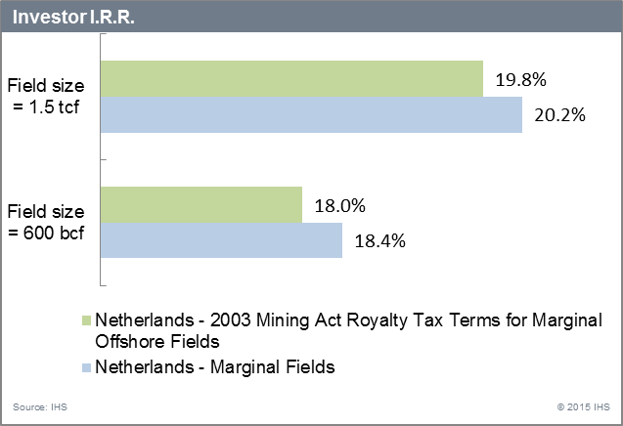
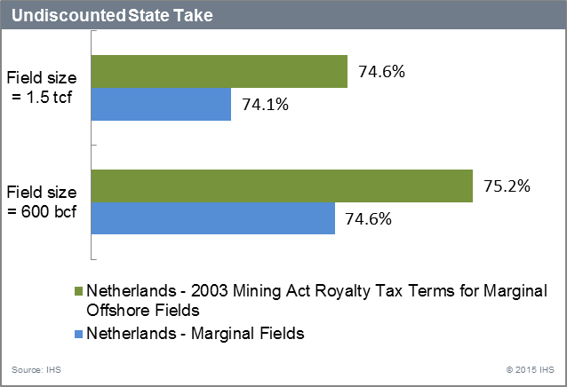
Impact of the Marginal Fields Terms
Source: IHS PEPS
24

Slide 25
Nigeria – Fiscal environment
Fiscal regimes applicable in the Nigeria:
2000 PSA Terms for Inland Basins
2000 Royalty Tax Terms On & Off-shore less than 200m
2007 Bid Round PSA Terms for Deep Offshore
2007 Bid Round PSA Terms for Niger Delta
Fiscal regime applicable to this study
FISCAL REGIME | Fixed royalty tax terms except for bonuses Assumptions for signature bonuses are based on the minimum signature bonus specified for blocks in water depths between 100m and 200m in the year 2000 Licensing Round; production bonuses are indicative of those agreed in the 1990s
BONUSES | Signature bonus of US$10 million * Production bonuses of US$5 million * at 50 Mbbl/d (300 MMcf/d) and 100 Mbbl/d (600 MMcf/d)
OTHER PAYMENTS | Local Content Development Levy equal to 1% of opex and capex (except bonuses) payable to the Nigerian Content Development Fund
STATE PARTICIPATION | None *
ROYALTY | 18.5% of gross revenue
COST RECOVERY | Not applicable
PROFIT SHARING | Not applicable
MINOR & INDIRECT TAXES | Oil projects only: 5% VAT%; 20% Import Duties; 6% Port Development Fee; 1% Inspection Fee Education Tax: 2% of assessable profit (gross revenue less royalty and contract "Operating Costs")
INCOME TAX | 65.75% (increasing to 85% after 5 years of production) of income less deductions and depreciation
ADDITIONAL PROFITS TAX | None
DOMESTIC SUPPLY OBLIGATION | None
!
!
Note: Where special terms for marginal fields may be available they are marked with “!”
* Where terms are negotiable/ biddable/ variable, this analysis makes assumptions about those terms which IHS believe are "indicative" of terms negotiated recently.
Source: IHS PEPS

Slide 26
Nigeria Marginal Fields Terms (1/2)
Marginal fields definition
A field that has reserves booked and reported annually and remained un-produced for more than 10 years (onshore & shallow)
Fiscal instrument(s) | Model Terms 2000 Royalty Tax Terms On & Off-shore less than 200m | Special Terms for Marginal Fields
Signature Bonus | US$10,000,000 | US$300,000
Royalty | 18.5% of gross revenue | Royalty based on production level: 2.5% (production<5,000 bbl/d) 7.5% (5,000 bbl/d<production<10,000 bbl/d) 12.5% (10,000 bbl/d<production<15,000 bbl/d) 18.5% (15,000 bbl/d<production<25,000 bbl/d)
Other fees, not modelled here, have been stipulated for marginal fields. It is not clear weather these payments also apply under the general terms:
  Indigenous companies (non-refundable)
    Application fee 200,000 naira/ field
    Bid processing fee 300,000 naira/ field
  Foreign companies (non-refundable)
    Application fee US$1,600
    Processing fee US$3,200
  Pre-qualified bidder
  Data prying fee: US$3,000
  Access to data
    Data leasing fee US$15,000/ field
    Data services fee US$2,000 (optional, for assistance with the leased data)
Source: IHS PEPS

Slide 27
Nigeria Marginal Fields Terms (2/2)
Marginal fields definition
A field that has reserves booked and reported annually and remained un-produced for more than 10 years (onshore & shallow)
Previous changes:
  2013:
  Marginal Fields Guidelines (2nd Marginal Fields Licensing Round which is not yet finalised; further information not expected until after 2015 elections):
    Objectives: grow production/ expand the upstream sector, increase reserves (especially in deeper plays), promote indigenous participation, increase technological transfer to indigenous companies
    Application for 3 fields maximum
    Applicants need to have i) Exploration and Production of Oil & Gas as one or the only area of activity, ii) 51% of the company to be owned by Nigerian nationals (incentive for indigenous companies but foreign companies to take part in the round by creating Nigerian companies), iii) participation of single partner in the consortia no higher than 25%, iv) experience in the O&G sector (at least one consortia member)
    Preferred presence of a technical partner (which can support more than one bidder)
    In the bid terms for the Marginal Bid Round 2013, the government reserves the right to participate at any time.
  2001:
  1st marginal fields round
  1996:
  Petroleum Act granting access, specifically to indigenous companies, to operate “un-attended” oil and gas fields in the country (especially in the Nigeria Delta). It is mentioned that, in many cases, these fields remained unproduced or only partially appraised.
Other remarks:
  Specifically, marginal fields shall have some or all of the following characteristics:
    Field remains undeveloped due to uncertain economic conditions
    No attempt at appraisal and development
    Field not profitable with current technology
    Fields with more gas than oil
    Fields abandoned for more than three years
    Fields available due to rationalization
    It should be noted that un-produced discoveries in open leases (blocks) do not qualify for farm-out as they would constitute part of the whole acreage that would be awarded in new license rounds.
Source: IHS PEPS

Slide 28
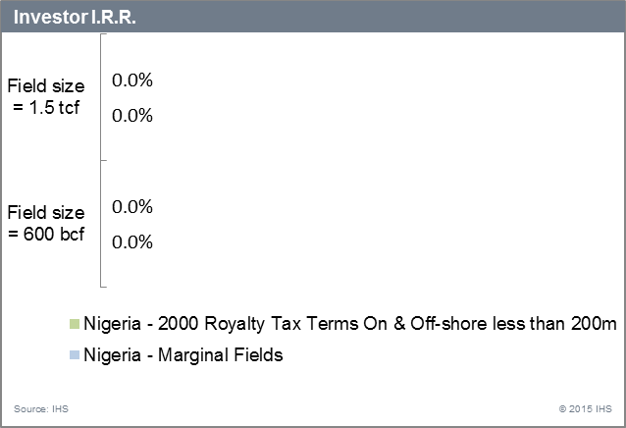
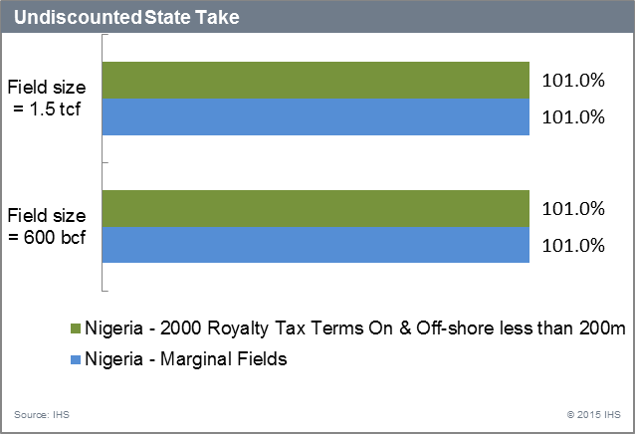
Impact of the Marginal Fields Terms
N/A
N/A
N/A
N/A
Note: Projects are not economic under these set of parameters and fiscal terms for the two gas field sizes that have been selected for this study (600 bcf and 1.5 tcf).
Source: IHS PEPS
28

Slide 29
Norway – Fiscal environment
Fiscal regimes applicable in the Norway:
Royalty Tax Terms
Fiscal regime applicable to this study
FISCAL REGIME | Fixed royalty tax terms except for state participation, which is variable - indicative rate from APA 2010 - APA 2012 Rounds is assumed
BONUSES | None
OTHER PAYMENTS | None
STATE PARTICIPATION | State participates from day one as a working interest partner 20% * is assumed here
ROYALTY | None
COST RECOVERY | Not applicable
PROFIT SHARING | Not applicable
INCOME TAX | Known as corporate income tax and levied at a rate of 27% on gross revenue less deductions and depreciation
ADDITIONAL PROFITS TAX | Known as special petroleum tax and levied at a rate of 51% on gross revenue less deductions and depreciation, including 22% uplift on development capex (5.5% over 4 years)
DOMESTIC SUPPLY OBLIGATION | None
WITHHOLDING TAX | None
!
Note: Where special terms for marginal fields may be available they are marked with “!”
* Where terms are negotiable/ biddable/ variable, this analysis makes assumptions about those terms which IHS believe are "indicative" of terms negotiated recently.
Source: IHS PEPS

Slide 30
Norway Marginal Fields Terms
Marginal fields definition
Resource potential considered small
Profitability likely to be low
“Old fields" (those developed before 1986)
Fiscal instrument(s) | Model Terms Royalty Tax Terms | Special Terms for Marginal Fields
Special Petroleum Tax (SPT) | The SPT uplift (an additional deduction to the taxable base for SPT) was reduced in May 2013 for new investments, from 7.5% per annum of the original cost price of depreciable operating assets to 5.5% (i.e. from 30% to 22% nominally over the four year period for which it is available). Note: The Ministry of Finance stated that this change is intended to ‘lead to more efficient use of resources and over time lead to increased tax revenues’. However, concerns have been raised by the industry with regards to the profitability of marginal fields (previously the 7.5% uplift was considered an incentive for the development of the marginal fields).
Note: Investor IRR and Undiscounted State Take have been calculated here for the 2004 and 2013 uplift to illustrate the previous impact of this incentive.
Previous changes:
  2004:
  Stimulate exploration activity and development of marginal fields by cash payments by the state deficits related to exploration activities or if a company increases its activities in the Norwegian Continental Shelf, acceleration of uplift on acquisition costs (to 7.5% over 4 years from 5% over 6 years) and simplification of tax treatment related to license transactions.
  1999:
  No state participation stipulated in licenses for which the resource potential is considered small and profitability likely to be low. Otherwise the government will take an interest of 25%.
  1992:
  "Old fields" (i.e. those developed before 1986), which were not eligible for the production allowance, received an uplift on capital costs of 16.667% for 15 years (i.e. a multiple of 2.5 uplift).
Other remarks:
  All costs relating to decommissioning activities are deductible for income tax.
Source: IHS PEPS

Slide 31
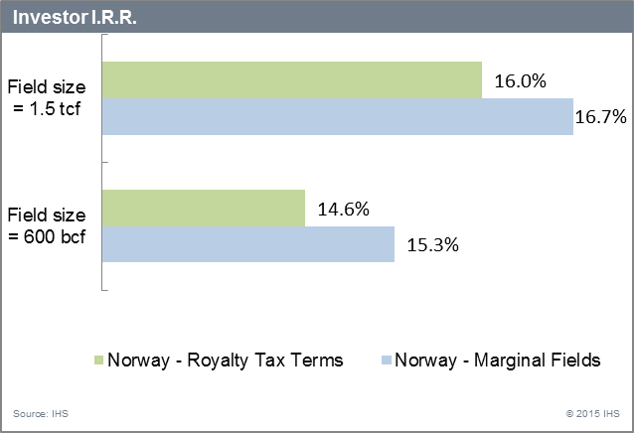
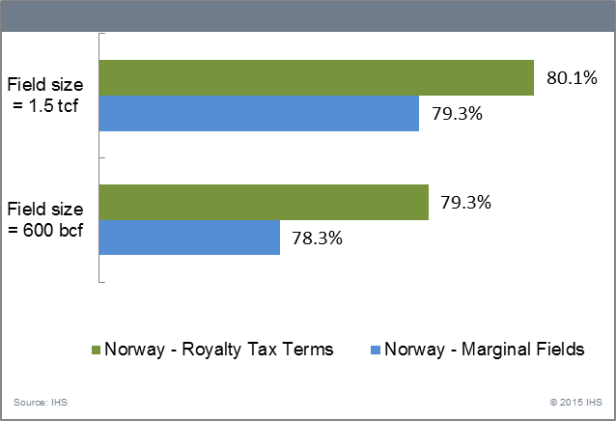
Impact of the Marginal Fields Terms
Note: The terms for marginal fields considered in the calculations are those from 2004.
Source: IHS PEPS
31

Slide 32
Pakistan – Fiscal environment
Fiscal regimes applicable in the Pakistan :
2012 Petroleum Policy Concession Terms Onshore
2012 Petroleum Policy PSA Terms Offshore less than 200m
2012 Petroleum Policy PSA Terms Deep Water 200m-1000m
2012 Petroleum Policy PSA Terms Ultra Deep Water greater than 1000m
Fiscal regime applicable to this study
FISCAL REGIME | Concession terms for onshore E&P under the 2012 Petroleum Policy and 2013 Model Concession Agreement Minimum social welfare amounts for Zones II & III
BONUSES | Production bonuses of US$ 0.6 million - US$ 7 million linked to cumulative production
OTHER PAYMENTS | Annual Training Fee of US$ 25,000 * during exploration phase rising to US$ 50,000 during development and production phases Annual Social Welfare contributions of US$ 30,000 * during pre-production phase rising to US$ 37,500 - US$ 525,000 depending on daily production rate during production phase
STATE PARTICIPATION | None
ROYALTY | 12.5% of gross revenue
COST RECOVERY | Not applicable
PROFIT SHARING | Not applicable
INCOME TAX | 40% of revenue less deductions (including depletion allowance) and depreciation Depletion Allowance: 15% of gross revenue but not exceeding 50% of profits before the deduction of such allowance
WINDFALL LEVY | Oil: 40% of windfall profits if sale price exceeds base price of US$ 40/bbl (escalated by US$ 0.5/bbl p.a. from production start date); Gas: 40% of windfall profits if 3rd party sale price exceeds base price (zone price for government-nominated buyers linked to Reference Crude Price)
IMPORT DUTY | Assumed at 5% * (weighted average) of tangible development costs
DOMESTIC SUPPLY OBLIGATION | None modelled
!
!
Note: Where special terms for marginal fields may be available they are marked with “!”
Source: IHS PEPS
* Where terms are negotiable/ biddable/ variable, this analysis makes assumptions about those terms which IHS believe are "indicative" of terms negotiated recently.

Slide 33
Pakistan Marginal Fields Terms
Marginal fields definition
Oil or gas reservoir that cannot be exploited economically (re-development & discoveries). More details provided on the following slide
Fiscal instrument(s) | Model Terms 2012 Petroleum Policy Concession Terms Onshore | Special Terms for Marginal Fields
Production Bonus | Production bonuses of US$ 0.6 million at start of commercial production. | No first production bonus.
Windfall Levy (Third Parties Gas Sale) | For sales of gas to parties other than government, a 40% windfall levy is applicable if the third party sale price exceeds the base price: Windfall Levy (WLG) = 40% x (Third Party Sale Price - Base Price) x (Volume of Gas sold to Third Party excluding Royalty) Note: Pricing of gas is indexed to the cost and freight price of a basket of Arabian/Persian crude oil imported into Pakistan. | For sale of gas to third parties, a windfall levy of 50% is applicable: Windfall Levy = 50% x (Third Party Sale Price – Base Price) x Volume of gas sold to third party Note: 1) Base price = US$ 8/MMBtu. 2) It is unclear in the terms for marginal fields if the Royalty is excluded from the volume of gas sold as in the case of the general terms.
Note: The impact of the windfall levy has not been considered in the calculation of the Investor IRR and the Undisclosed State Take due to the lack of information on the pricing applied by the Government. However, the impact of the production bonus has been assessed.
Other remarks:
  Under the 2013 Marginal/Stranded Gas Guidelines other terms, relevant for this study, have been stipulated:
    The 2012 Petroleum Policy and the 2013 model agreement provide for a Windfall Levy on gas in case gas is sold to a third party other than the government. For the sale of gas to parties other than government, a Windfall Levy is applicable on the difference between the applicable government zonal gas price and the third party sale price.
    Gas price is set according to the 2012 Petroleum Policy with an additional premium of US$ 0.25/MMBtu for the three zones (Zone I, II and III).
    The government has the first right to purchase pipeline marginal gas that has been converted to pipeline quality gas. If the government does not exercise its right within 90 days, then working interest owners are free to sell the gas to a third party.
    The gas is to be delivered at the outlet flange (i.e. field gate or delivery point) which may be anywhere within a 3km radius from the outlet flange of the production facility. For sale of gas to third parties where the Sui Gas Pipelines (SSGCL and SNGPL) are not available, a real or virtual pipeline may be laid or used.
    Subject to internal market requirements, rightholders may request the government to purchase 90% of their pipeline specification gas. The remaining 10% may be offered to transmission and distribution companies and third parties.
Source: IHS PEPS

Slide 34
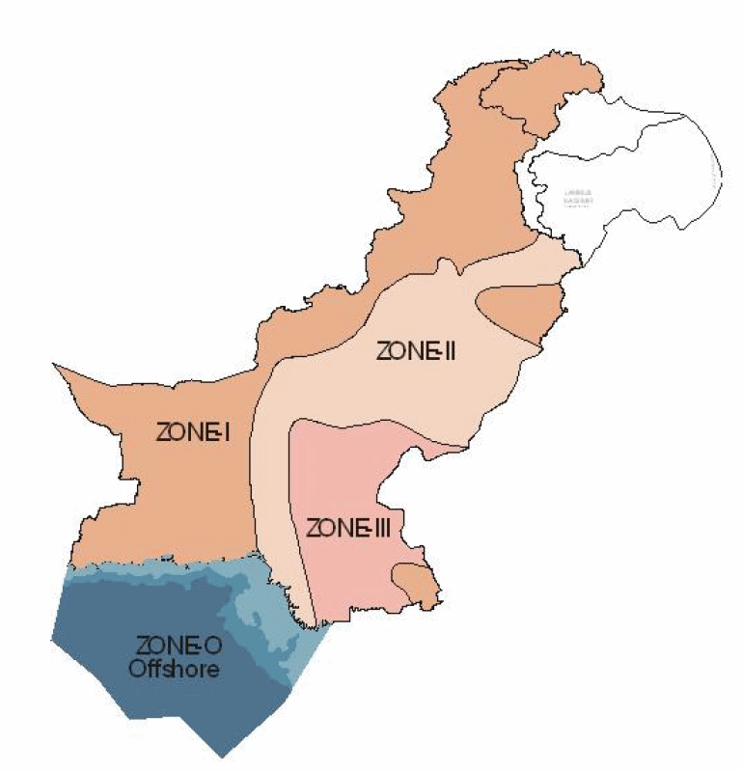
Pakistan Marginal Fields - Definition
1. Reservoir sizes considered for stranded fields are:
2. Also considered are reservoirs that are certified to be compartmentalized and for which the size of the individual marginal/stranded compartments is smaller than the reservoir size mentioned above; and
3. Depleting fields that are nearly at the end of their economical production life and that require secondary/tertiary recovery methods.
The government may also approve fields or discoveries as marginal by considering the following:
Initial well Productivity
Recoverable Volume
Lack of appropriate technology
Remoteness of the Area
Distance to infrastructure and
Economics of field development at current price
Zones | Reservoir Size (Bcf)
Zone I | 25
Zone II | 20
Zone III | 15
Source: IHS PEPS

Slide 35
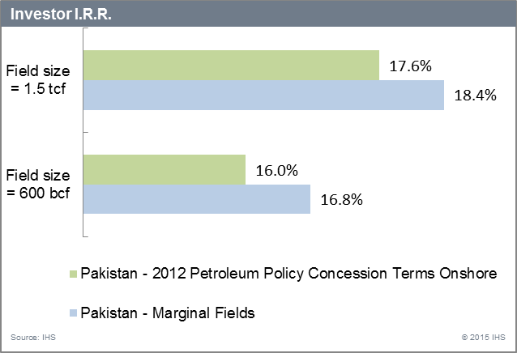
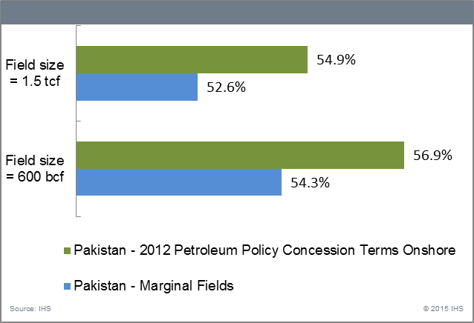
Impact of the Marginal Fields Terms
Source: IHS PEPS
35

Slide 36
Peru – Fiscal environment (1/2)
Fiscal regimes applicable in Peru :
2010 Model Contract with Production-based Royalty under 2003 Royalty Regs
2010 Model Contract with R-factor Royalty under 2003 Royalty Regs
Fiscal regime applicable to this study
FISCAL REGIME | Fixed royalty tax terms based on 2010 Model Contract and 2003 Royalty Regulations Royalty rates on a sliding scale linked to average daily production
BONUSES | None
OTHER PAYMENTS | Annual training fee of US$ 50,000 during the pre-production phase rising to a maximum of US$ 180,000 when production exceeds 50 Mbbl/d
STATE PARTICIPATION | None
ROYALTY | 5% when production < 5Mbbl/d rising by 0.1575% for each additional Mbbl/d of production to a maximum of 20% when production > 100 Mbbl/d
COST RECOVERY | Not applicable
PROFIT SHARING | Not applicable
INCOME TAX | Labour Participation Share: 5% of income less deductions and depreciation Income Tax: 30% of income less deductions, depreciation, and labour participation share
ADDITIONAL PROFITS TAX | None
DOMESTIC SUPPLY OBLIGATION | None
WITHHOLDING TAX | None
!
Note: Where special terms for marginal fields may be available they are marked with “!”
Both fiscal regimes could apply to a field, hence both are analyzed in this study and included in the quantitative analysis
Source: IHS PEPS

Slide 37
Peru – Fiscal environment (2/2)
Fiscal regime applicable to this study
FISCAL REGIME | Fixed royalty tax terms based on 2010 Model Contract and 2003 Royalty Regulations Royalty rates on a sliding scale linked to economic results (as measured by an R-factor)
BONUSES | None
OTHER PAYMENTS | Annual training fee of US$ 50,000 during the pre-production phase rising to a maximum of US$ 180,000 when production exceeds 50 Mbbl/d
STATE PARTICIPATION | None
ROYALTY | Fixed royalty of 5% plus variable royalty in the range 0% to 20% depending on R-factor after R > 1.15
COST RECOVERY | Not applicable
PROFIT SHARING | Not applicable
INCOME TAX | Labour Participation Share: 5% of income less deductions and depreciation Income Tax: 30% of income less deductions, depreciation, and labour participation share
ADDITIONAL PROFITS TAX | None
DOMESTIC SUPPLY OBLIGATION | None
WITHHOLDING TAX | None
!
Note: Where special terms for marginal fields may be available they are marked with “!”
Source: IHS PEPS

Slide 38
Peru Marginal Fields Terms
Marginal fields definition
Reduced or significantly declining production rates requiring investments to increase production
Fiscal instrument(s) | Model Terms 2010 Model Contract with Production-based Royalty under 2003 Royalty Regulations / 2010 Model Contract with R-factor Royalty under 2003 Royalty Regulations / | Special Terms for Marginal Fields
Royalty | R-factor Royalty Contract 5% plus variable royalty in the range 0% to 20% depending on R-factor after R > 1.15 Production-based Royalty Contract 5% when production < 5Mbbl/d rising by 0.1575% for each additional Mbbl/d of production to a maximum of 20% when production > 100 Mbbl/d | The November 2003 Law on Marginal Field Incentives stipulated that lower royalty rates may be agreed in the case of lack of transportation infrastructure, heavy oil fields and marginal fields (existing fields with reduced or declining production).
Note: In the calculation of the Investor IRR and the Undisclosed State Take , IHS has assumed that the royalty has been reduced to 5%.
Previous changes:
  2002:
  Decree providing for a 30% reduction in royalty rates (however, not lower than 13.8%) to incentivise investors for a commercial discovery made within the first 4 years of the contract. Effective until the R-factor = 1.3.
  2001:
  Decree providing for a royalty rate reduction applicable to incremental production from areas with reduced or significantly declining production rates and which would require new and significant investments to increase production. This Decree was revoked in November 2003.
  2000:
  Decree providing for a 10% minimum royalty rate (water depths 200 - 400 m) and a 5% minimum rate (water depths greater than 400 m). These royalties were established to be lower than those described by the 1993 Royalty Regulations. This Decree was revoked in May 2003.
Other remarks:
  2003:
  Royalty Regulations provide the investor with the option to choose between a royalty rate based on daily production or an R-factor. The choice is to be made upon the declaration of a commercial discovery.
Source: IHS PEPS

Slide 39
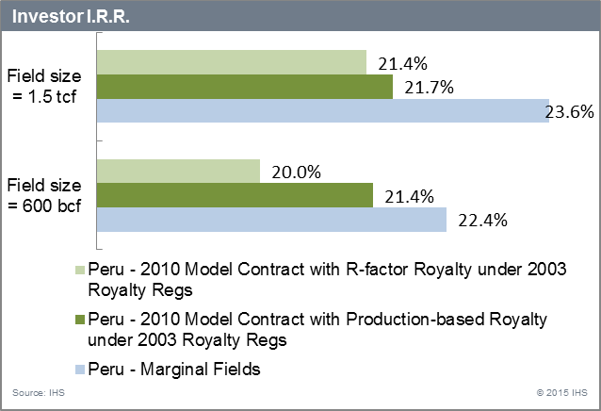
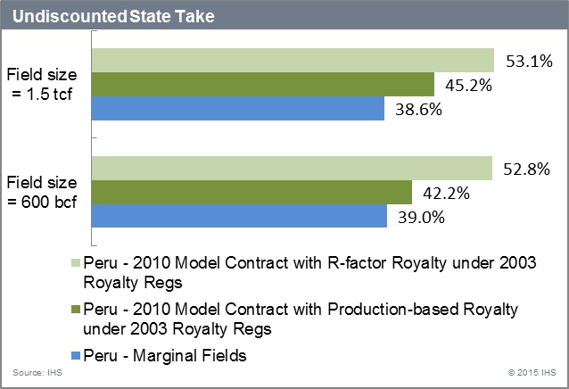
Impact of the Marginal Fields Terms
Source: IHS PEPS
39

Slide 40
Russia – Fiscal environment
Fiscal regimes applicable in the Russia :
Royalty/Tax Joint Ventures
Fiscal regime applicable to this study
FISCAL REGIME | Fixed royalty tax terms applicable from 1 January 2002
BONUSES | Signature bonus of US$ 1 million *
OTHER PAYMENTS | None
STATE PARTICIPATION | None
VAT | Levied at 18% on sales to the domestic market; sales to the export market are zero-rated
EXPORT DUTY | Levied on production exported from Russia: Regular rate of 105.8.7 US$ per tonne (14.499 US$/bbl) applies to crude oil exports in the month of March 2015 (a lower rate of 13.3 US$ per tonne (1.82 US$/bbl)) applies to superviscous oil ; the rate for crude oil is set every month Rate for natural gas is not modelled as we assume all gas is sold domestically to Gazprom which has a monopoly on the export of natural gas from Russia and therefore will assume liability for the export duty on natural gas
ROYALTY | Known as Minerals Production Tax (MPT) and levied on physical production.
COST RECOVERY | Not applicable
PROFIT SHARING | Not applicable
INCOME TAX | 20% of revenue less deductions and depreciation
OTHER TAXES | Property Tax: 2% of cumulative capex less cumulative capex depreciation Land Pollution Tax: 0.1% of opex Unified Social Tax: 21% of 'salary fund'; salary fund assumed to be equal to 6% of opex Excise Tax: 30% of gas sales under international agreements
!
!
!
Note: Where special terms for marginal fields may be available they are marked with “!”
Source: IHS PEPS
* Where terms are negotiable/ biddable/ variable, this analysis makes assumptions about those terms which IHS believe are "indicative" of terms negotiated recently.

Slide 41
Russia Marginal Fields Terms (1/3)
Marginal fields definition
No definition provided but special terms are applicable to heavy oil fields, mature fields, fields located in less accessible regions
Fiscal instrument(s) | Model Terms Royalty/Tax Joint Ventures | Special Terms for Marginal Fields
Export Duty | Regular rate of oil export duty is applicable if oil price exceeds US$ 25/bbl. | Oil with viscosity greater than 10,000 mPa s qualifies for a reduced export duty rate at 10% of the regular rate. Certain crudes from producing fields which have reached 80% depletion or produced from fields located fully or partially in certain regions benefit from a reduced export duty rate. “New offshore fields” with at least 50% of the area located in Kara Sea, northern part of Barents Sea and eastern Arctic qualify for export duty exemptions .
Royalty (Minerals Production Tax – MPT) | MPT rate for crude oil introduced by presidential amendment in November 2014: K * C_{P} - E_{M} K is a constant (Ruble/ tonne) C_{P} is a factor reflecting the level of world oil prices (“price coefficient”) E_{M} is a new factor reflecting specific aspects of oil extraction The new factor E_{M} will be calculated as follows: E_{M} = K_{MPT} * C_{P} * (1 - C_{D} * C_{R} * C_{DIF} * C_{DD} * C_{CAN}) K_{MPT} is set at RUR 766/tonne in 2015 and RUR 857/tonne in 2016 and RUR 919/tonne in 2017 and thereafter C_{D}, C_{R}, C_{DIF} and C_{DD} (see next slide for more details) C_{CAN} is a new factor reflecting the geography and quality of oil | Certain oil fields qualify for a zero-rate MPT: heavy oilfields (viscosity over 10,000 mPa), oil fields located entirely or partially in certain regions. The reduced MPT rate will be calculated by assigning the factor C_{CAN} a value of zero. Natural gas produced by Gazprom and its affiliates (with Gazprom’s share of over 50%) from fields located entirely or partially in certain regions and placed in commercial production after 1 January 2018 qualify for zero-rate MPT for 15 years from the commencement of commercial production. After 15 years, MPT will increase gradually until reaching the full rate in the 25th year from the commencement of commercial production.
Assets Tax | This is a regional tax set by the regions subject to a maximum of 2.2%. However, with effect from January 2013, rates of assets tax set by regions for certain types of assets including, inter alia, cross-country pipelines may not exceed: 1.0% in 2015, 1.3% in 2016, 1.6% in 2017 and 1.9% in 2018. | Tangible assets of cross-country pipelines and gas extraction facilities of Gazprom and its affiliates (with Gazprom’s share of over 50%) located in certain regions and commissioned after 1 January 2015 will be exempt from assets tax. It is understood this incentive is aimed at Gazprom’s pipeline Power of Siberia intended for export of natural gas to China.
Note: Incentives are directed towards marginal OIL fields. The main focus of this study is gas fields (given Karish and Tanin are gas discoveries), hence the summary on Russia is included for reference only.
Source: IHS PEPS

Slide 42
Russia Marginal Fields Terms (2/3)
Marginal fields definition
No definition provided but special terms are applicable to heavy oil fields, mature fields, fields located in less accessible regions
Previous changes:
  2013 (with effect from January 1st, 2014):
  MPT rates:
    Approximately 20% of the value of crude oil when oil prices are greater than 50 US$/bbl
    Approximately 2.69 US$/bbl for condensate in 2013 rising to 3.10 US$/bbl in 2015 and thereafter
    Approximately 0.38 US$/Mcf on natural gas in late 2013 rising to 0.44 US$/Mcf in 2014 and 0.52 US$/Mcf in 2015
  The MPT rate for crude oil is a product of a constant (base rate) and factors which reflect the level of world oil prices, depletion, size of the field reserves and degree of difficulty in extracting the resource: K * Cp * Cd * Cr * Cdif * Cdd
  Cd is a factor reflecting the level of depletion of reserves located within the subsoil block (“depletion coefficient”). It is assigned a value in the range from 0.3 to 1.0 once the recoverable reserves in the development plan are more than 80% depleted.
    If an oilfield contains “difficult to recover”’ oil deposits (i.e. Cdif < 1.0), Cd = 1.0 (see below for the definition of Cdif).
  Cr is a factor reflecting the size of reserves (“reserves coefficient”) in the early years of a project. It is assigned a value of less than 1.0 for oilfields with initial recoverable reserves of less than 5 million tonnes providing cumulative production has not exceeded 5% of the recoverable reserves as follows: Cr = 0.125 * R + 0.375 ( R = initial recoverable reserves expressed in million tonnes).
    For oilfields with initial recoverable reserves equal to or greater than 5 million tonnes and/or with cumulative production in excess of 5% of the reserve size, Cr = 1.0.
    Small oilfields (i.e. fields with recoverable reserves of up to 5 million tonnes) will benefit from the reduced MPT at the beginning of their production stage.
  Cdif is a factor reflecting the degree of difficulty of oil recovery.
  Cdd is a factor reflecting the level of depletion of a particular hydrocarbon deposit. For subsoil plots that contain “difficult to recover” oil deposits (i.e. Cdif < 1.0), Cdd is assigned a value in the range from 0.3 to 1.0.
  2012:
    Introduction of the MPT
    Introduction of Cr, a factor reflecting the size of reserves. As a result, small oilfields (fields with recoverable reserves of up to 5 million tonnes) are set to benefit from reduced MPT rate at the beginning of their production stage.
  2011:
    Reduced export duty for oil mature fields applicable betwen October 2011 and January 2014 (part of the so called “60-66” regime)
Note: MPT is levied on de-watered stabilised oil, gas condensate and non-associated natural gas. Separation of light fractions and other impurities from gas condensate is permitted prior to the calculation of MPT.
Source: IHS PEPS

Slide 43
Russia Marginal Fields Terms (3/3)
Marginal fields definition
No definition provided but special terms are applicable to heavy oil fields, mature fields, fields located in less accessible regions
Other remarks:
  VAT levied at 18% on sales to the domestic market; sales to the export market are zero-rated.
  There is no provision in the legislation for the licensee to supply any portion of its crude oil or natural gas production to the domestic market.
    Production from most concession licenses is sold into both export and domestic markets, with production sold to the latter being priced at a significant discount to the export price.
Source: IHS PEPS

Slide 44
Thailand – Fiscal environment
Fiscal regimes applicable in the Thailand :
Thai III Royalty Tax Terms Deep Water greater than 200m
Thai III Royalty Tax Terms Offshore less than 200m
Thai III Royalty Tax Terms Onshore
Fiscal regime applicable to this study
FISCAL REGIME | Fixed royalty tax terms for deep water areas (>200 m) based on the 2007 Model Concession Agreement issued in connection with the 20th Licensing Round SRB calculations ("K" factor) for Andaman Sea deep water blocks offered in the 19th Licensing Round in 2005
BONUSES | None
OTHER PAYMENTS | Training fee of US$ 50,000 p.a.
STATE PARTICIPATION | None
ROYALTY | 3.5% - 10.5% of gross production on an incremental sliding scale linked to average daily production
COST RECOVERY | Not applicable
PROFIT SHARING | Not applicable
INCOME TAX | 50% of gross revenue less deduction and depreciation Special discount applies to the revenue for tax purposes during the first 9 years of production
SPECIAL REMUNERATORY BENEFIT | Levied on pre-tax "annual petroleum profit" 0% - 75% on an incremental scale linked to annual revenue per metre depth of well
DOMESTIC SUPPLY OBLIGATION | None
WITHHOLDING TAX | None
!
!
Note: Where special terms for marginal fields may be available they are marked with “!”
Source: IHS PEPS

Slide 45
Thailand Marginal Fields Terms (1/2)
Marginal fields definition
Terms designed such that unprofitable fields, fields with unfavorable geology & deep water fields benefit from more attractive terms
Fiscal Instrument(s) | Model Terms Thai III Royalty Tax Terms Deep Water greater than 200m | Special Terms for Marginal Fields
Income Tax | Special discount applies to the revenue for tax purposes during the first nine years of production. Discount Rate = (Basic Discount Rate x Volume of Standard Daily Production) / Average Actual Daily Production where Basic Discount Rate = (1.05% x Average Water Depth in Metres) / 30; and Volume of Standard Daily Production = [(150 bbl x Number of Production Wells) x Average Water Depth in Metres] / 30. Note: IHS assumes that similar formula applies for gas.
Special Remuneration Benefit (SRB) | The SRB rate levied depends on the "annual revenue (in Thai Baht) per one metre depth of well". The SRB rate is: 0% when the annual revenue per metre depth of well < THB 4,800 (US$ 145.5) rising to a maximum of 75% when the annual revenue per metre > THB 87,360 (US$ 2,647) Note: K is a depth in metres of wells drilled in the exploration block which the Government allows the concessionaire to apply as a factor in calculation in order to reduce the payment of Special Remuneratory Benefit. K is based on the geological conditions of the exploration block and the statistical data on petroleum exploration and production expenditure required for areas with similar geological conditions to the exploration block concerned. K is subject to a minimum value of 150,000. Wells which have produced an aggregate of more than 100,000 bbl or which have been abandoned by the concessionaire may not be counted in the total of cumulative metres drilled.
Note: Given the nature of the incentives (linked to the meters of wells drilled) and the limitations of the methodology (hypothetical gas fields) IHS cannot assess quantitative impact of the marginal fields terms in Thailand on economic indicators. These terms are illustrated here as an example of a country where the generally applicable fiscal regime also has mechanism catering for marginal fields.
Source: IHS PEPS

Slide 46
Thailand Marginal Fields Terms (2/2)
Marginal fields definition
Terms designed such that unprofitable fields, fields with unfavorable geology & deep water fields benefit from more attractive terms
Previous changes:
  2007:
  Increasing the ceiling rate from 30% to 90% and the term to five years for royalty reductions in fields with unfavourable geological conditions, where production rates are falling or where the cost of production is abnormally high.
  2000-2002 (18th bid round):
  New incentives were introduced in the form of a fixed 35% special reduction rate and (generally) higher K factors for calculation of the Special Remuneratory Benefit (600,000 for the Gulf of Thailand and up to 1,200,000 for deep water blocks in the Andaman Sea). Otherwise the Thai III fiscal regime remained unchanged.
  1995:
  Several changes to licence and fiscal terms were introduced for the 14th and subsequent rounds though still within the Thai III framework.:
    Increase in the SRB special reduction to 10% onshore, 25% offshore Gulf of Thailand and shallow waters of the Andaman Sea and 35% in the deep waters of the Andaman Sea
    Increasing the SRB geological constant (K factor) from a range of 150,000 - 180,000 metres (depending on the area) to 150,000 - 1,200,000 metres
  1989:
  Thai III Terms: The revision of terms was intended to make exploration in Thailand more attractive to companies. The general intention was to make the marginal fields characteristic of Thailand more attractive while penalising profitable fields more heavily.
Source: IHS PEPS

Slide 47
Yemen – Fiscal environment
Fiscal regimes applicable in the Yemen:
2008 PSA Terms
Fiscal regime applicable to this study
FISCAL REGIME | Negotiable production sharing terms based on the 2008 model contract
BONUSES | Negotiable signature bonus - US$ 1 million * Negotiable discovery bonus - US$ 1 million * Negotiable production bonuses at 25, 50, 75, 100, & 150 Mbbl/d and 150, 300, 450, 600, & 900 MMcf/d: bonuses ranging from US$ 1 million to US$ 5 million *
OTHER PAYMENTS | Five different biddable annual fees - a total of US$ 1 million per annum * Fixed tax of 3% of exploration expenditures *
STATE PARTICIPATION | Yemen Oil and Gas Company has negotiable interest carried through the project without repayment of its share of carried costs; 10% * carried interest
ROYALTY | Oil: 6.5% - 15% on an incremental sliding scale tied to average daily production Gas: 15% once cumulative production has reached 1 MMcf
COST RECOVERY | From a maximum of 35% * of gross production less royalty
PROFIT SHARING | 35% - 15% * on an incremental sliding scale based on average daily production
INCOME TAX | Paid by the state from its share of revenue
ADDITIONAL PROFITS TAX | None
DOMESTIC SUPPLY OBLIGATION | None
WITHHOLDING TAX | Exempt
!
Note: Where special terms for marginal fields may be available they are marked with “!”
Source: IHS PEPS
* Where terms are negotiable/ biddable/ variable, this analysis makes assumptions about those terms which IHS believe are "indicative" of terms negotiated recently.

Slide 48
Yemen Marginal Fields Terms
Marginal fields definition
No definition provided. It is understood to be fields requiring additional incentives in order to become profitable
Fiscal Instrument(s) | Model Terms 2008 PSA Terms | Special Terms for Marginal Fields
Cost Recovery | From a maximum of 35% of gross production less royalty. | A maximum of 70% cost recovery ceiling it is understood to be applied for marginal fields.
Note: This incentive has been introduced following the impact of both disappointing exploration results and the 1993 civil war which led to the re-negotiation of some contracts in late 1994/early 1995. It is unclear if this ceiling is currently applicable. However for the purpose of the illustration, a 70% cost recovery is considered in the calculation of the Investor IRR and the Undiscounted State Take..
Other remarks:
  The contractor's income tax (i.e. any taxes that are measured by income, profit or turnover) is paid by the Ministry of Oil and Minerals (MOM) out of the state's share of crude oil under the 2008 model contract. The contractor must nonetheless file income tax statements.
  The contractor may export crude oil free of export duties.
Source: IHS PEPS

Slide 49
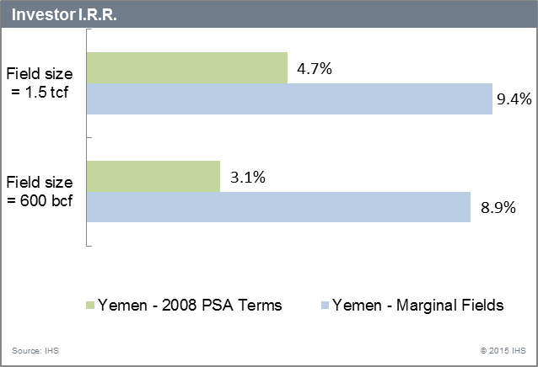
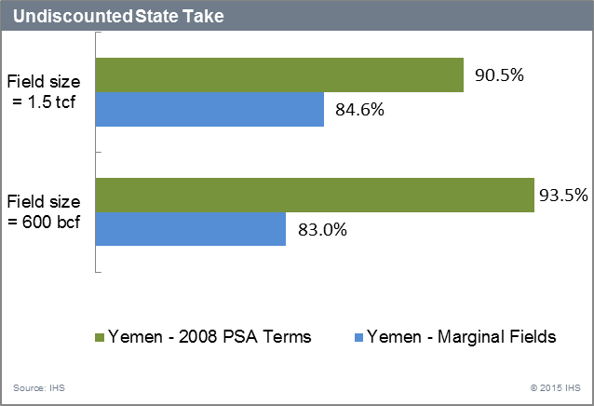
Impact of the Marginal Fields Terms
Source: IHS PEPS
49

Slide 50
United Kingdom – Fiscal environment
Fiscal regimes applicable in the United Kingdom:
2015 Royalty Tax Terms
Fiscal regime applicable to this study
FISCAL REGIME | Fixed terms including Budget 2015 proposals regarding supplementary charge (not including basin allowance)
BONUSES | None
OTHER PAYMENTS | None
STATE PARTICIPATION | None
ROYALTY | None
COST RECOVERY | Not applicable
PROFIT SHARING | Not applicable
INCOME TAX | 30% of gross revenue less deductions and depreciation.
ADDITIONAL PROFITS TAX | Supplementary charge levied at 20% on the same taxable base as for income tax (except for financing costs)
DOMESTIC SUPPLY OBLIGATION | None
WITHHOLDING TAX | None
!
Note: Where special terms for marginal fields may be available they are marked with “!”
Source: IHS PEPS

Slide 51
UK Marginal Fields Terms
Marginal fields definition
Prior to 2015, small fields, ultra heavy oil fields, ultra high temperature/high pressure fields , deep water gas fields, large deep water oil fields, and large shallow water gas fields.
Fiscal instrument(s) | Model Terms 2015 Royalty Tax Terms | Special Terms for Marginal Fields
Additional Profits Tax (Supplementary Charge - SC) | With effect from 1 April 2015, the previous system of field allowances (see below) is replaced by a basin allowance. Like the field allowances before it, the basin allowance is deductible from the taxable income subject to supplementary charge. The basin allowance is equal to 62.5% of 'qualifying investment capital expenditure' incurred on or after 1 April 2015. Note: The new basin allowance aims to provide tax relief to (mostly mature) UK fields. To evaluate the effect of this incentive, this study will compare the currently applicable fiscal terms with a set of general model terms which exclude the allowance.
Previous changes:
  2012:
  The definition of small fields is amended to include fields with recoverable reserves below 50 MMboe given development consent on or after 21 March 2012.
  Field allowance is granted to large deep water oil fields (recoverable reserves < 400 MMboe; water depth > 1,000m) given development consent after 20 March 2012.
  Field allowance is granted to large shallow water gas fields (recoverable reserves > 350 Bcf; water depth < 30 m) given development consent after 23 July 2012.
  2010:
  Field allowance is granted to gas fields located in deep water (>300 m) more than 60 km from pipeline infrastructure and given development consent after 3 March 2010.
  2009:
  Small oil and gas fields (recoverable reserves < 25.55 MMboe), ultra heavy oil fields, ultra high temperature/high pressure fields given development approval on or after 22 April 2009 benefit from an allowance (field allowance) which is deductible from the taxable base subject to supplementary charge.
    The field allowance for offshore fields is a fixed amount per field and is subject to an annual limit.
    The field allowance is distributed among the field's licensees in proportion to their working interests in the field.
    The field allowance is accessed over a minimum period of 5 years meaning the maximum annual amount of field allowance is equal to 20% of the total field allowance.
Source: IHS PEPS

Slide 52
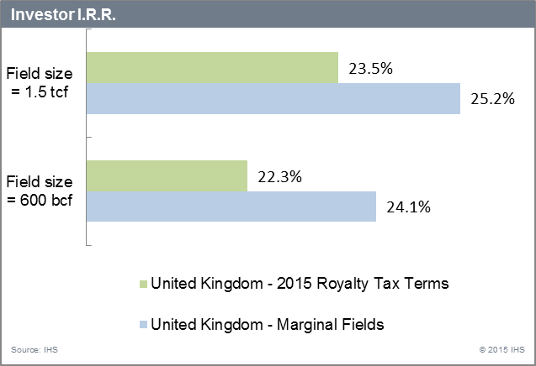
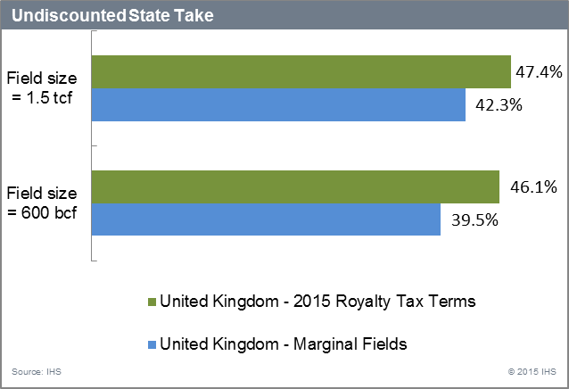
Impact of the Marginal Fields Terms
Note: the assumed 2015 Royalty Tax Terms used in the analysis exclude the new basin allowance, while the Marginal Fields Terms include it. This is done purely to illustrate the impact of the new basin allowance.
52

Slide 53
Other examples of countries offering special terms for marginal fields
Scarce information on marginal fields has been tracked on the countries below. Therefore it is unclear what incentive packages are proposed for investors and whether these incentives still apply. These countries have been also selected to illustrate a variety of definitions for marginal fields: certain water depths, reserves volumes, depleting fields or fields requiring enhanced oil recovery etc. :
  Angola: The 2004 Petroleum Tax Law makes provision for the payment of a tax on production (i.e. royalty) at a rate of 20%. The rate of royalty may be reduced to 10% at the discretion of the NOC, in the case of production from marginal fields, offshore areas (water depths > 750 metres) and onshore frontier areas which are difficult to access. Also, the Ministry may authorise the flaring of associated gas in case of marginal or small discoveries in order to make the exploitation of the discoveries viable.
  Note: Petroleum produced under the terms of production sharing contract is specifically exempt from the PPT therefore IHS does not model this tax in the fiscal regime available.
  Cameroon: A special package of incentives for marginal field development (reserves of up to 20 million barrels) was introduced in 1995 in an attempt to attract investment in shut-in discoveries. The package effectively permitted the parties to tailor-make fiscal terms. In 1998 further fiscal measures were introduced on a basin-by-basin basis.
  Colombia: introduction in 1997/ 1998 a small-fields contract for existing marginal discoveries.
  Indonesia: there are two types of contractual arrangements for the re-development of existing fields:
    Enhanced Oil Recovery (EOR) Contract introduced in 1987 to encourage enhanced recovery in oil fields operated by Pertamina. EOR operations are those carried out for the recovery of incremental oil by employing EOR techniques.
    Technical Assistance Contract (TAC) used in the late 1960s and re-introduced in the early 1990s for depleting and shut-in oil and gas fields operated by Pertamina. TACs are based on the contractor having a 100 % interest in the field and is the most common type of field re-development contract awarded in recent years. TAC operations are those carried out for the recovery of incremental oil and gas by rehabilitating producing and shut-in fields.
  Trinidad & Tobago: According to the 2006 model contract for deep water (not applicable to onshore or shallow), the contractor must notify the Minister whether it considers the discovery of crude oil to be a marginal discovery. Under this contract, the Minister may approve the retention of a "marginal" discovery for up to 3 years from the date of discovery. This retention duration has been stipulated in previous contracts. If a gas discovery is made, the retention period may be up to 7 years.
Source: IHS PEPS

Slide 54
Content
Objectives
Approach
Executive summary
Analysis by country
Appendix

Slide 55
Petroleum Economics & Policy Solutions
Legal, fiscal, political and regulatory analysis
High-level introduction to above ground risks in E&P:
  Legal, fiscal & contractual terms
  Business environment (Transactions analysis & political risk)
  Environmental terms
  E&P statistics (trends over 10 years)
  Rating & Ranking Index
“One-stop shop” for information on current terms for new entrants in 180 countries
Laws, Contracts & Bid Round Information database
3,500 online; 13,000 in archive
Standardised reports
legal, fiscal, contractual, environmental and commercial terms
130 detail; 180 summary
Comparative analysis of 200+ fiscal regimes
Bonuses, State Participation, Royalty,
Production Sharing, Income Tax, Additional Profits Tax,
Domestic Supply Obligation, Dividend Withholding Tax

Slide 56
PEPS Fiscal Benchmarking Methodology
IHS has developed a number of analytical methodologies and tools for the effective comparison of fiscal regimes. In this report, the methodology has been applied to compare two fiscal regimes within the same country: generally applicable terms and special terms for marginal fields.
    Analysis is done on a consistent basis with the only variable being the fiscal regimes themselves.
    This fiscal analysis methodology is intended to allow the comparison of upstream petroleum fiscal regimes around the world (or in this report – two fiscal regimes within the same country), rather than model any particular known field developments themselves. It is, therefore, provided in this report only for quantitative illustration of how marginal fields’ incentives could impact project economics within a given country.
    This methodology has been adopted in order to reflect the impact of the fiscal terms only (general and specific to marginal fields) and do not reflect true value that an investor company could obtain in a marginal field in these countries.

Slide 57

The key comparison criteria presented in the report are Undiscounted State Take (%) and Investor IRR (%)
The comparison is provided as an illustration of the impact that incentives for marginal fields can have on a project’s economic indicators.
Undiscounted State Take (%) and Investor IRR (%) were calculated on hypothetical gas projects and have been compared under the generally applicable terms and under special terms for marginal fields.
  The analysis considers the distribution of the Gross Project cash flow between the state and the investor. State Take is a figure that expresses the Total State Cash Flow as a percentage of the Gross Project Cash Flow:
      State Take % = 1 – Investor Cash Flow / Gross Project Cash Flow
      Gross Project Cash Flow = Gross Project Revenue - Gross Project E&A costs – Gross Project Development Costs – Gross Project Opex. In other words, Gross Project Cash Flow = State Cash Flow + Investor(s) Cash Flow
      State Cash Flow includes Government Cash Flow, i.e. Cash attributable to any State participation in a project (directly or as NOC).
Illustration of Investor IRR in a country under two fiscal regimes
Investor IRR improved by 3% as a result of the special terms for marginal fields
Investor IRR under Generally Applicable Terms
8%
Investor IRR under Special Terms for Marginal Fields
11%

Slide 58
Assumptions used in the calculation of economic indicators
    Investor IRR and Undiscounted State Take were calculated using the following standard assumptions in each of the analyzed countries:
      Two hypothetical gas fields sizes of 600bcm and 1.5 tcf. These field sizes were selected to be in line with Karish and Tanin volumes.
      Gas price is assumed at $6/mcf
      Each hypothetical field is assumed to be developed at the costs summarized in Table 1 below.
      Inflation rate of 3% per annum is applied to costs and prices.
      No economic limit is assumed, i.e. all fields produce their recoverable reserves, even if this means negative annual cashflow towards the end of project life – this ensures the full economic impact of each fiscal regime is properly reflected in the analysis.
      This analysis assumes the investor is a non-resident company of the country in which it is investing and that all net after-tax profits are repatriated as dividends (subject to withholding tax where applicable) to a non-resident parent company.
      Where fiscal terms are negotiable, biddable or variable, PEPS analysts make assumptions about those terms, which IHS believe are "indicative" of terms negotiated in the most recent contracts in each country. For the generally applicable terms, IHS chose the fiscal regime currently available in a country, and where possible – offshore (as such comparison is more relevant for the two Israeli fields).
Table 1.
Reserves (Bcf) | Total E&A Costs, $million | Total Development Costs, $million | Annual fixed opex, as % of cumulative development costs | Annual variable opex, $/mcf | Total Full Cycle cost (E&A cost + Development cost + Opex) cost, $/mcf
600 | 42.00 | 840.00 | 3% | 0.40 | 2.54
1,500 | 54.00 | 1,800.00 | 3% | 0.40 | 2.31

Slide 59
Main characteristics of the Tanin and Karish fields
Field Name | Tanin 1 | Karish 1
Disc Date Year | 2012 | 2013
Main Basin Name | Levantine Basin | Levantine Basin
Prod Status | Appraising | Appraising
HC Type | Gas | Gas,condensate
Terrain | Deep Water | Deep Water
Gas In Place PP (MMscf) | 850,000 | 2,500,000
Gas Recoverable PP (MMscf) | 592,000 | 1,282,000
Cond In Place PP (MMbbl) | N/A | 10.8 – 14.7 *
Cond Recoverable PP (MMbbl) | 0.791 | 13.700
Gas Remaining PP (MMscf) | 592,000 | 1,282,000
Cond Remaining PP (MMbbl) | 1 | 14
Total Hydrocarbon Remaining PP (MMboe) | 99 | 227
Numb Wells | 1 | 1
Source: IHS EDIN, * Delek Energy (contingent resources)

Slide 60
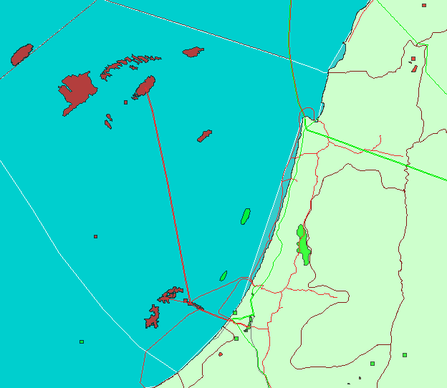
Location and infrastructure available
Karish 1
Tanin1
Source: IHS EDIN

