Slide 1


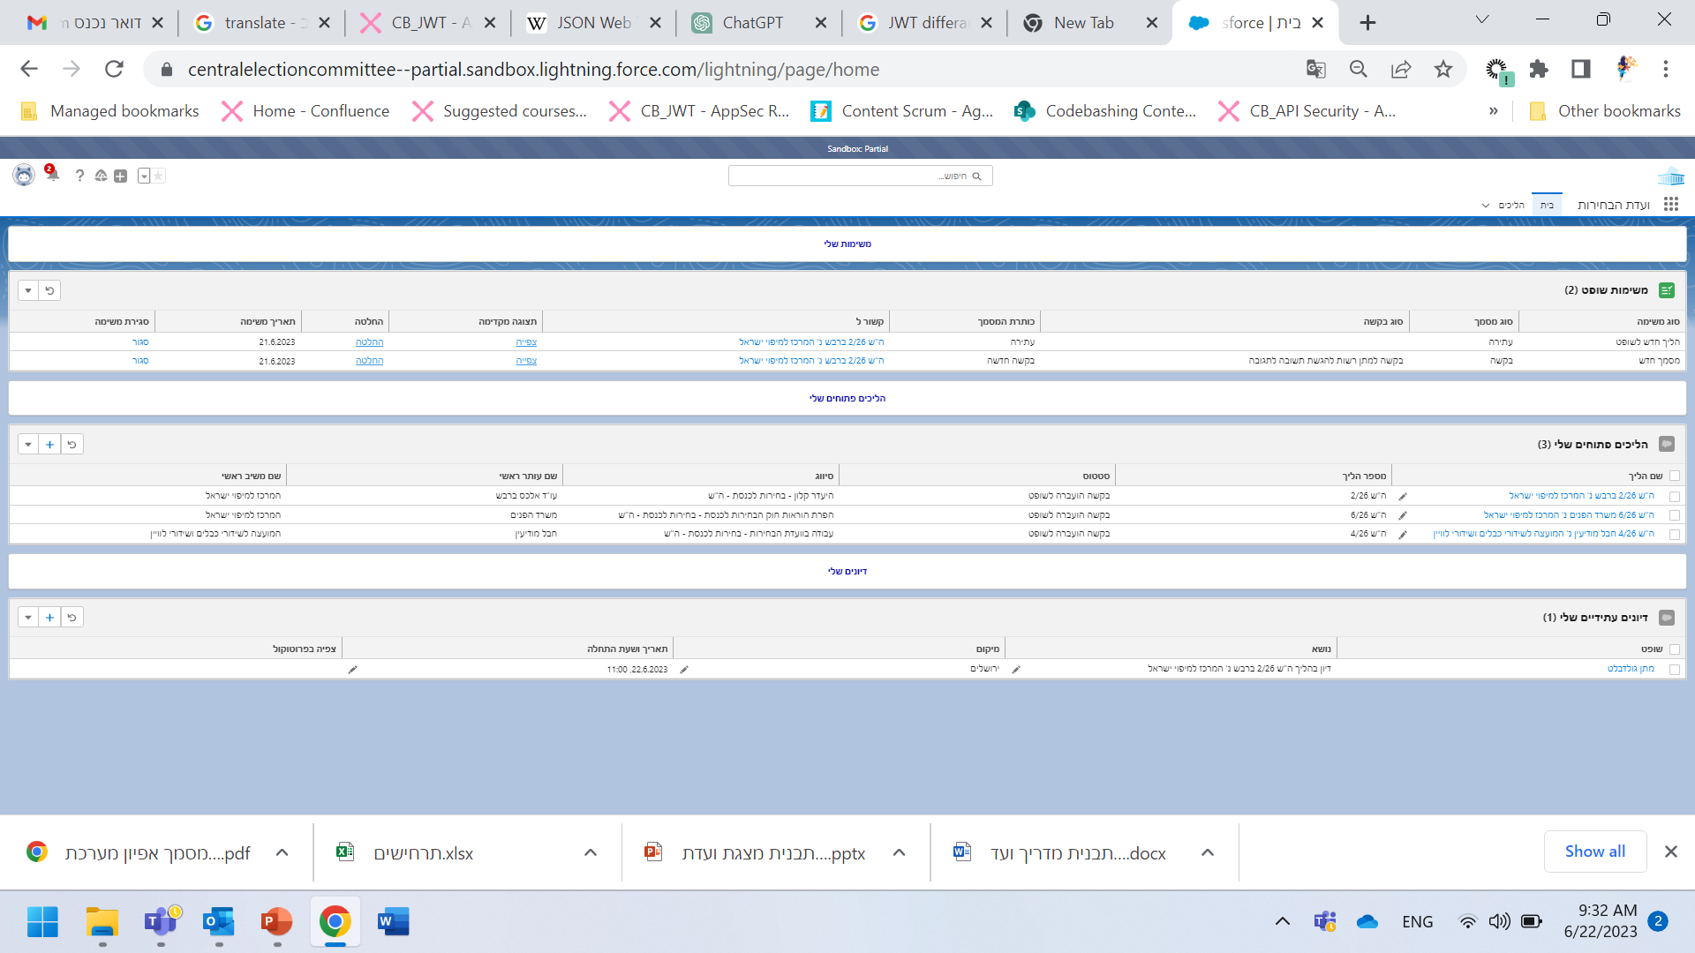

conducting Legal Proceedings Before the CEC Chairman
Petitions and Conducting Proceedings Using the Electronic Petition System
User Guide
[Side / Representative]
ועדת הבחירות | abra-it| 2023

Slide 2

2
Before we begin…
In this guide, you will learn about the electronic system for opening and conducting legal proceedings with the Knesset Central Elections Committee on the SALESFORCE platform.
The system allows users to:
- File a new petition / Open a new proceeding.
- Keep track of all stages of a process through one system, including viewing and conducting all relevant data and documents, in a simple and efficient manner, up to the ruling.
- Authorize legal firms to represent them.

Slide 3
3
Table of Contents
עמוד
פרק 1 – מערכת עתירות – נעים להכיר!
04
מילון סמלים כללי
05
כניסה למערכת
07
התמצאות בדף הבית
09
התמצאות במסך ההליך
פרק 2 – פתיחת הליך והגשת מסמכים
11
פתיחת הליך חדש
15
הגשת מסמך
פרק 3 – פעולות לעורכי דין
17
יצירת חשבון מייצג וניהול עורכי דין
18
הצהרה על ייצוג

Slide 4


מו
4
Chapter 1
Introducing the Electronic Petitions System
Glossary of Symbols and Icons
Main Symbols and Icons
Description | Icon
Button for viewing documents
Link to case or document [will always appear in blue]

Slide 5
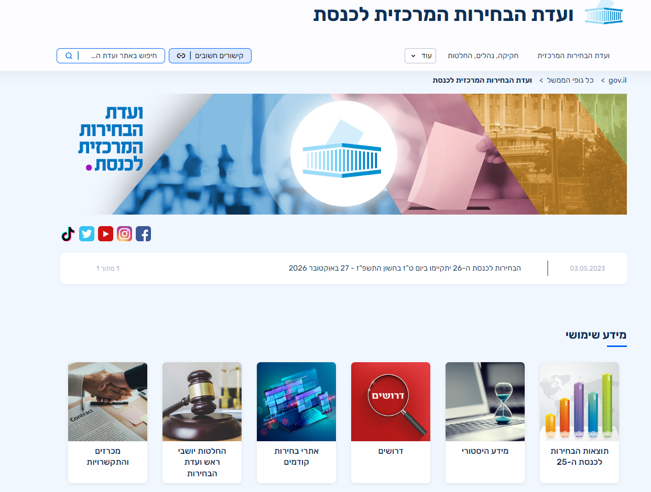
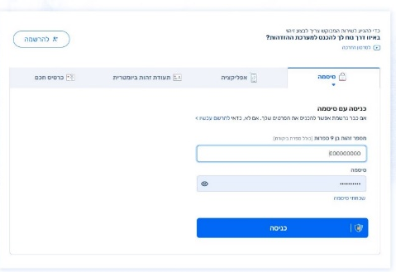
5
Chapter 1
Introducing the Electronic Petitions System
Logging into the System
How to Log into the System
Direct Login
 | Follow Link to Central Elections Committee Home Page and press the button to enter the electronic petitions system.
Login via the National Identification System
 | The next stage will confirm your identity in the National Identification System. If you do not have an account, register a new account with your personal data.

Slide 6
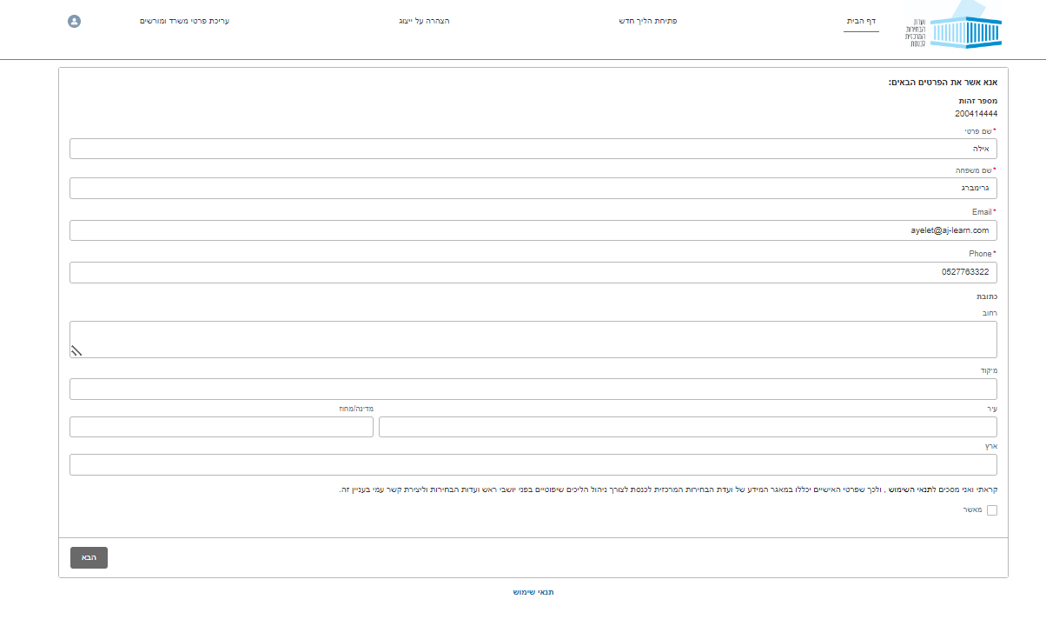
6
1Chapter
Introducing the Electronic Petitions System
Logging into the System
Confirming personal data
Initial login to the system
If this is the first time you are logging into the system, you will be asked to confirm your contact information. Be sure to fill in all the required details. After entering your contact information, you will be asked to accept the users’ conditions which appear at the bottom of the screen, and press “הבא” (Next).

Slide 7
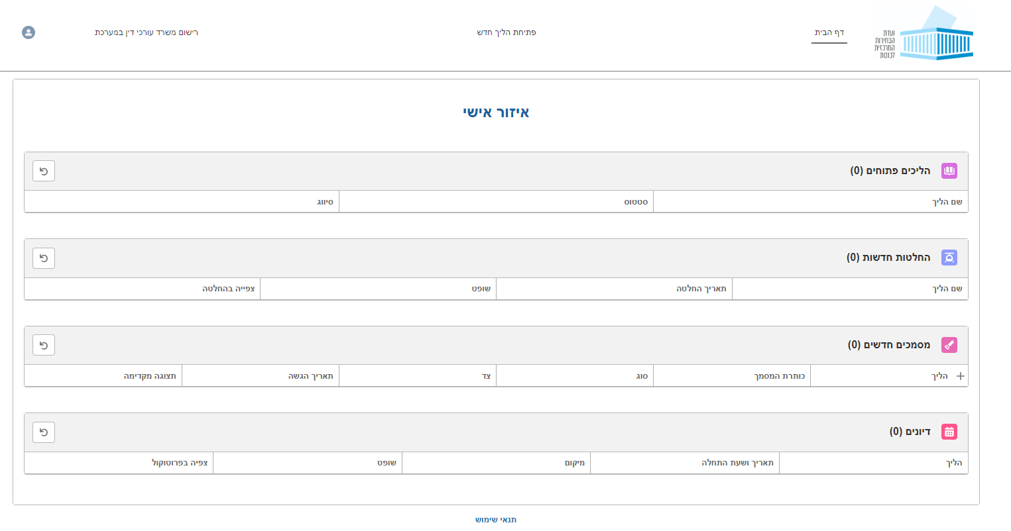
7
Chapter 1
Introducing the Electronic Petitions System
The Home Page
What does the home page look like?
Sections of the home page
On the home page, you will find 4 information sections: “הליכים פתוחים שלי” (My Ongoing Proceedings) allows users to view ongoing proceedings to which the user is a party. “החלטות חדשות” (New Rulings) shows all rulings made in the previous two weeks in proceedings to which the user is a party. “מסמכים חדשים” (New Documents) shows all documents added in the precious two weeks in proceedings to which the user is a party. “דיונים” (Deliberations) shows scheduled future deliberations to which the user is a party.

Slide 8
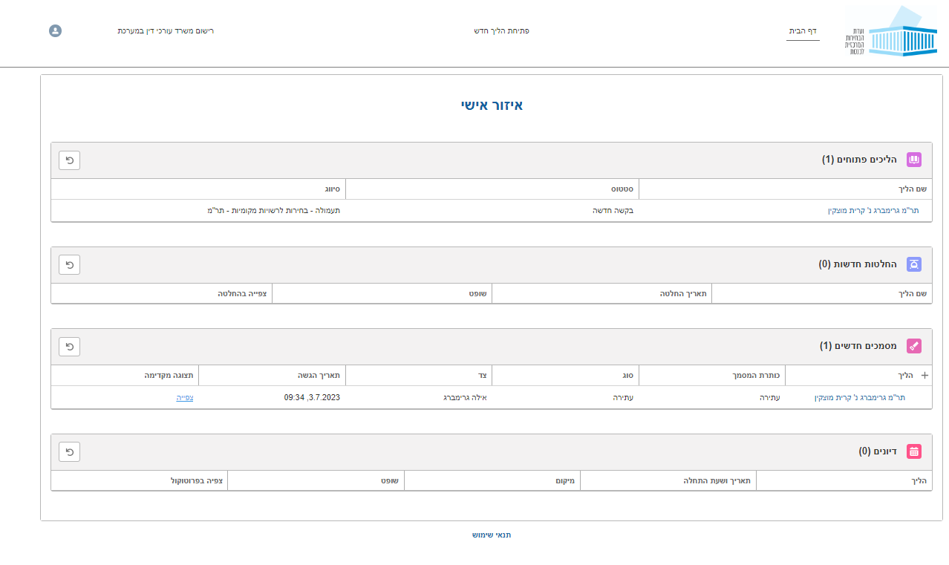
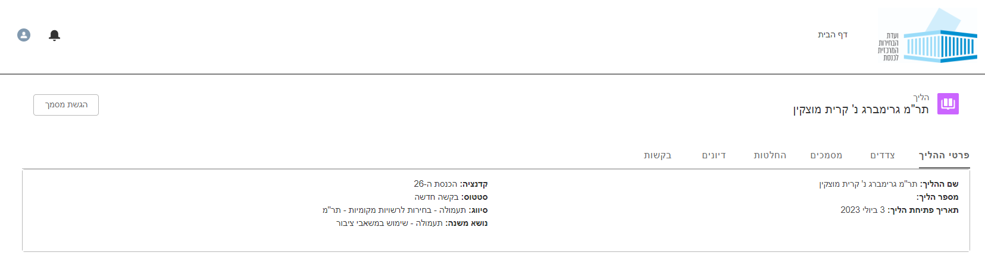
8
Chapter 1
Introducing the Electronic Petitions System
Navigating the Proceedings Screen
Proceedings Screen
Viewing case information
The Proceedings screen provides general information about the proceeding including case information, the various documents submitted, and any decisions made. How to view an ongoing proceeding: On the Home Page, press the name of the case [link appears in blue].
After choosing the case by name, you will be taken to the webpage of that case.

Slide 9

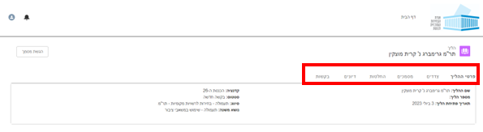
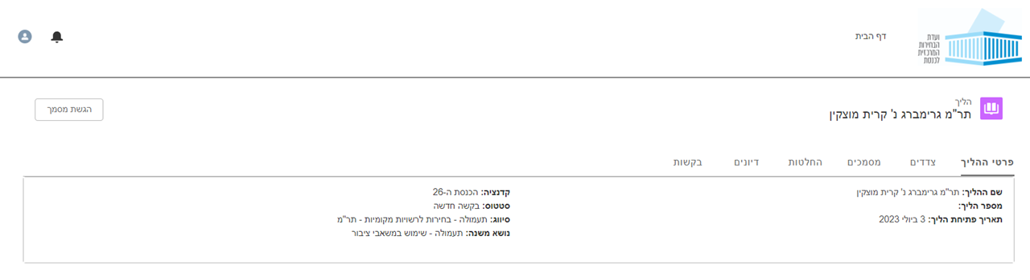
9
Chapter 1
Introducing the Electronic Petitions System
Navigating the Proceedings Screen
Proceedings Page – continued
Proceedings page – information tabs
. On the Proceedings screen, users can find information about a case by opening any of the following tabs: “פרטי ההליך“ (Case Information) - to view details of the case such as the case number and topic. “צדדים“ (patrties) - to view the petitioners’, respondents’, and representatives’ details. “מסמכים“ (Documents) to view all documents stored in the system which are relevant to the proceeding. “החלטות“ (Decisions) - to view all rulings made on the proceeding. דיונים”“ (Hearings) - to view information about scheduled future deliberations on the case. “בקשות" (Motions) - to view requests submitted and any related documents.
Proceedings page – Case Information
On the Proceedings page, users can find all the information regarding the classification of the case: -Case name -Case number -Date of Petitions -Knesset Number -Status -Classification -Secondary topic

Slide 10
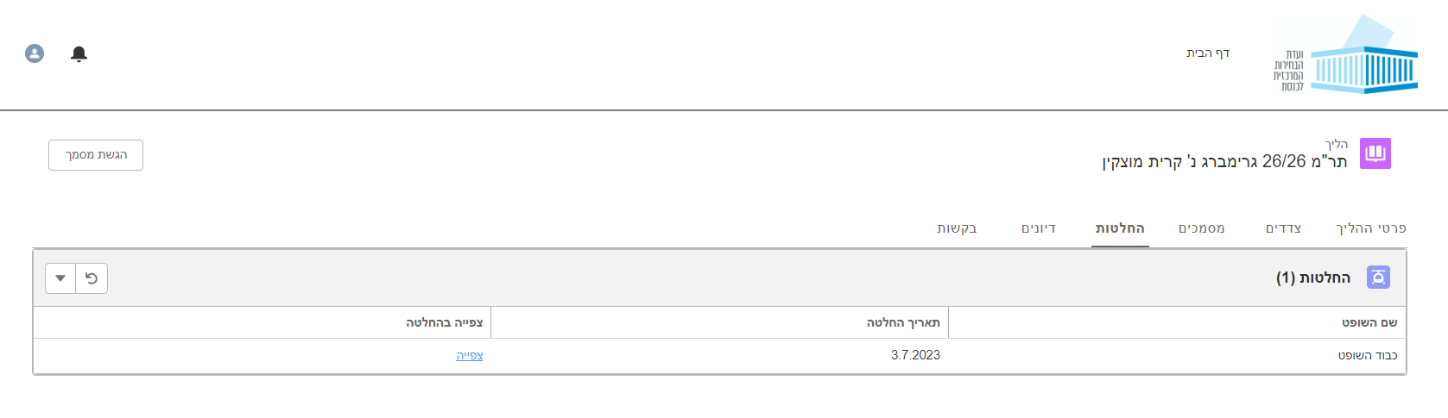
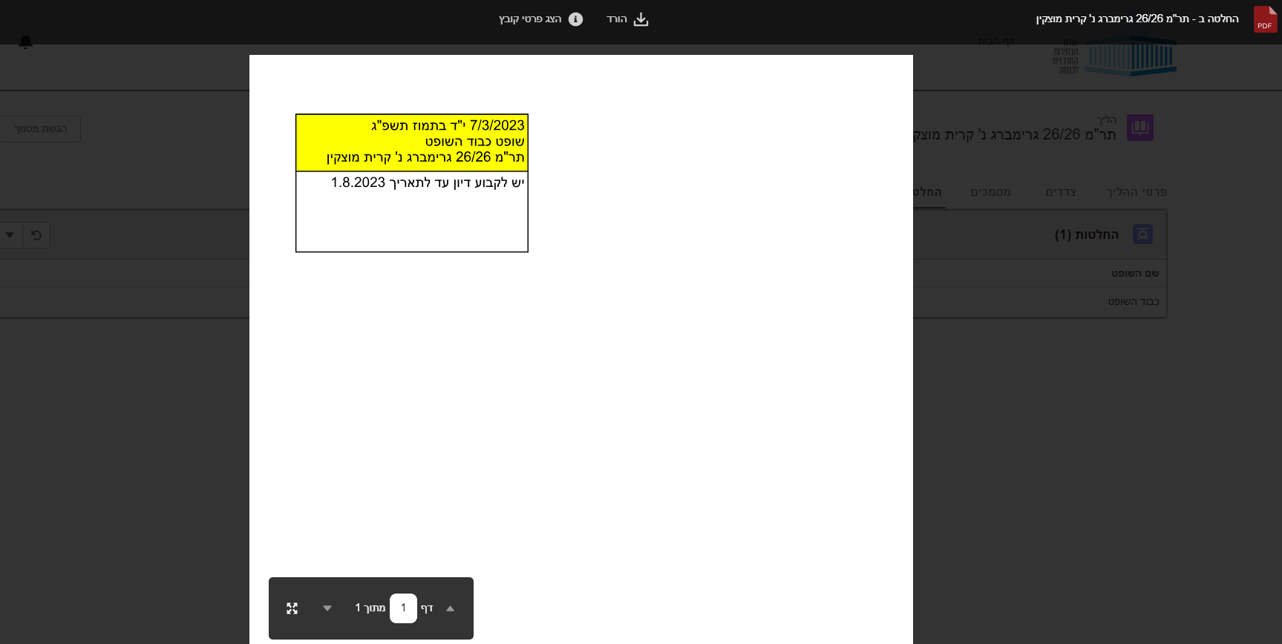
10
Chapter 1
Introducing the Electronic Petitions System
Navigating the Proceedings Screen
Proceedings screen
Viewing Rulings on the Case
 | Users interested in viewing Decisions can access them from the “מסמכים“ (Documents) or “החלטות“ (Decisions) tabs. Select the “צפייה“ (View) button.
 | After selecting “צפייה“ (View), the Rulings page will open..

Slide 11
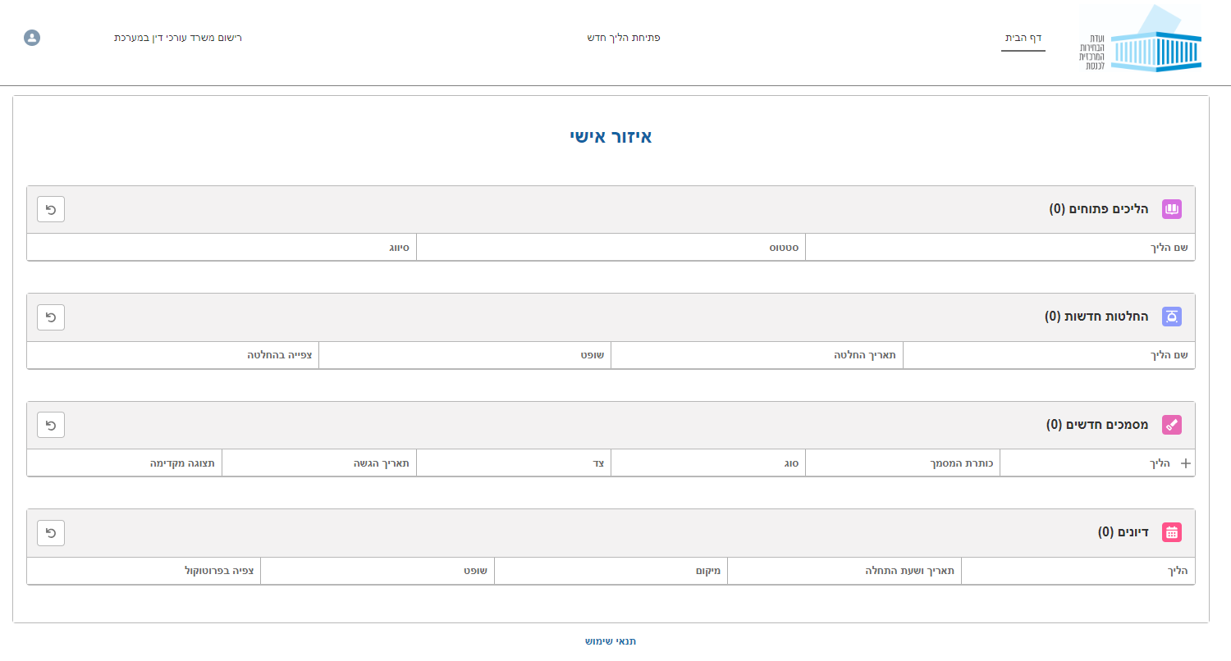
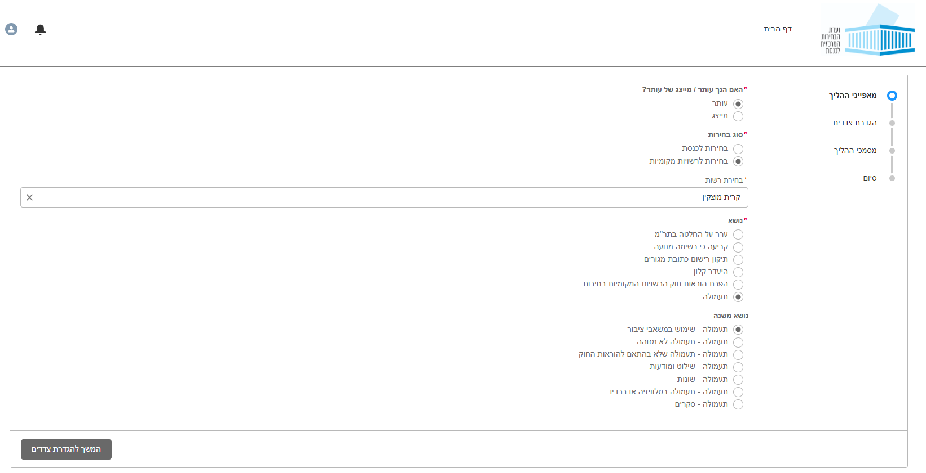
11
Chapter 2
Petitions a New Case and Submitting Documents
Petitions a New Case
Filing a new case in the system
How to File a New Proceeding
Petitions a new case is done in four steps: Describing the nature of the proceeding; Naming the parties involved; Adding documents; and Confirming and submitting forms. Press the button which says “פתיחת הליך חדש” (Filing a New Proceeding) which appears at the top of the page.
1. Nature of the Case
First, select the correct option – are you submitting the proceeding on behalf of yourself or are you representing the petitioners? After that, fill in details regarding the proceeding - to which kind of elections does it apply, what is the topic, and, in the case of municipal elections, the municipality / regional council name. After this, press the “המשך להגדרת צדדים” (Continue to Name Involved Parties) button.

Slide 12

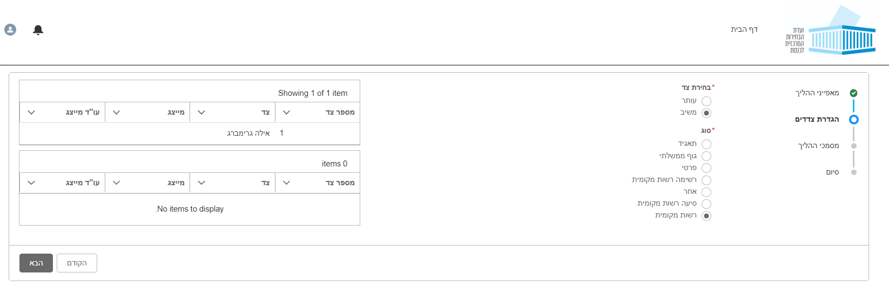
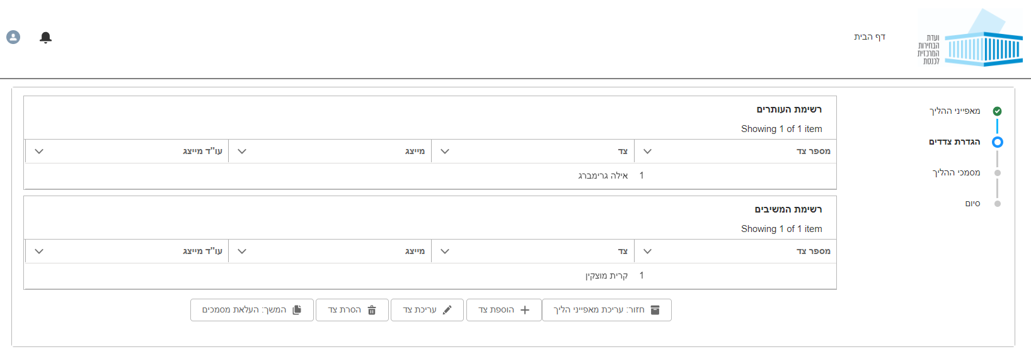
12
Filing a case
2. Naming the Involved Parties
Enter the names of the parties to the case. Each side entered will be added to a table. When you are finished, press theהבא” “ (Next) button.
Adding, Amending, and Removing Names
• In cases in which there are several different parties involved, users can add more names by pressing the הוספת צד”“ (Add Party) button. • If you need to edit or remove one of the parties, press theעריכת צד” “ (Edit Party) or “הסרת צד “ (Remove Party) button. When finished, press theהמשך: העלאת מסמכים” “ (Continue: Submit Documents) button.

Slide 13
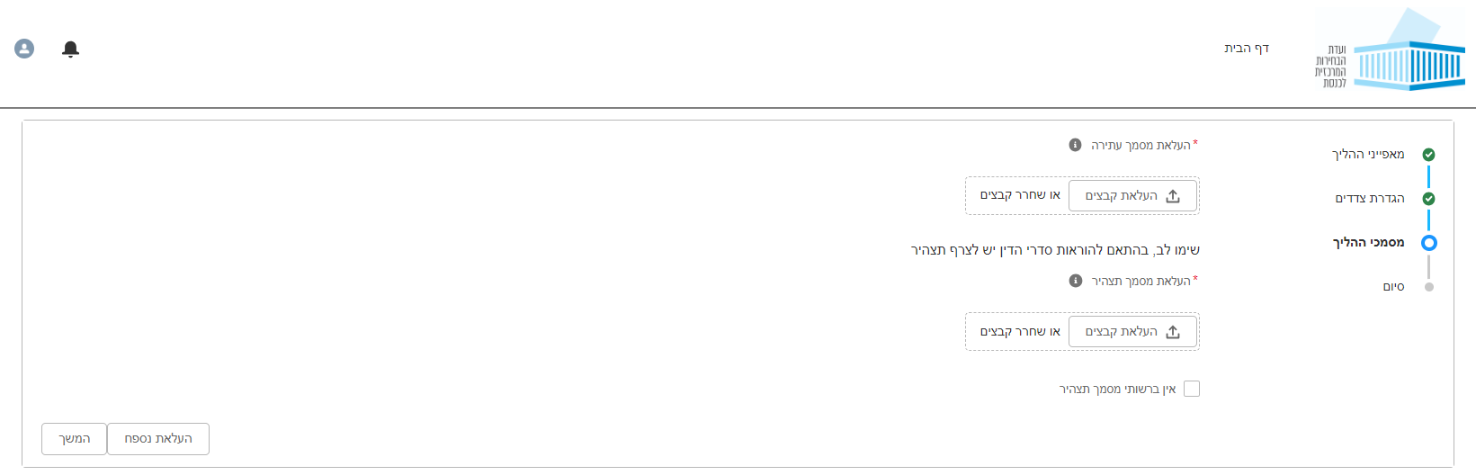
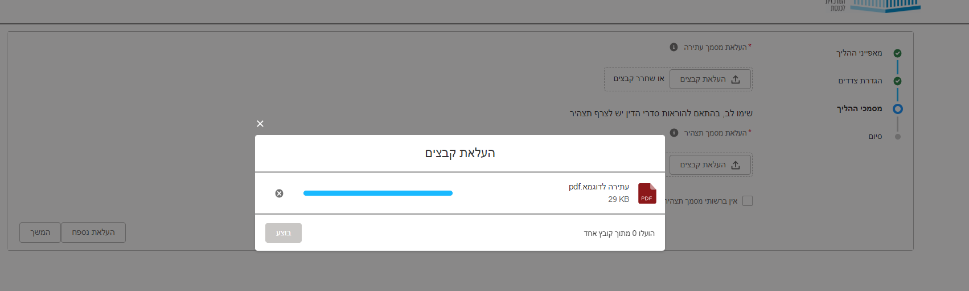
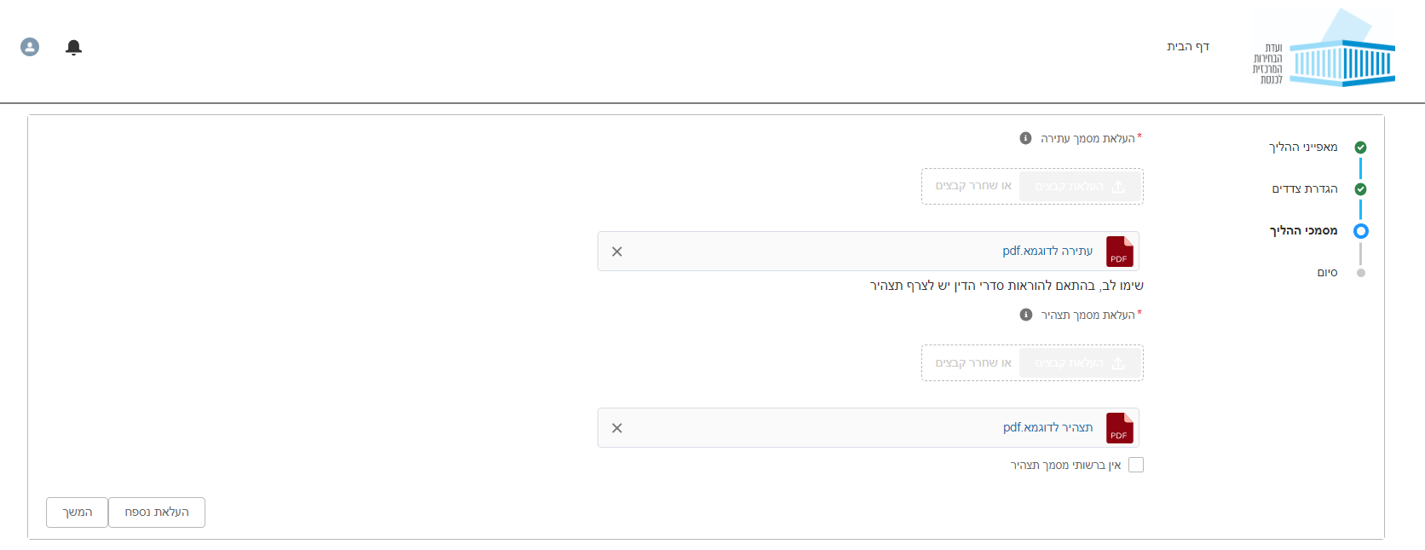
13
Filing a case – continued
3. Submitting Documents
Upload the required documents – the application, affidavits, and appendices – by pressing the “העלאת מסמכים“ (Submit Documents) button. When finished, press “המשך“ (Continue).
Please note: The application and affidavit must be submitted in PDF format only. However, appendices may be submitted in other file formats, including audio or video files, Word files and pictures. When finished, press “המשך“ (Continue).

Slide 14
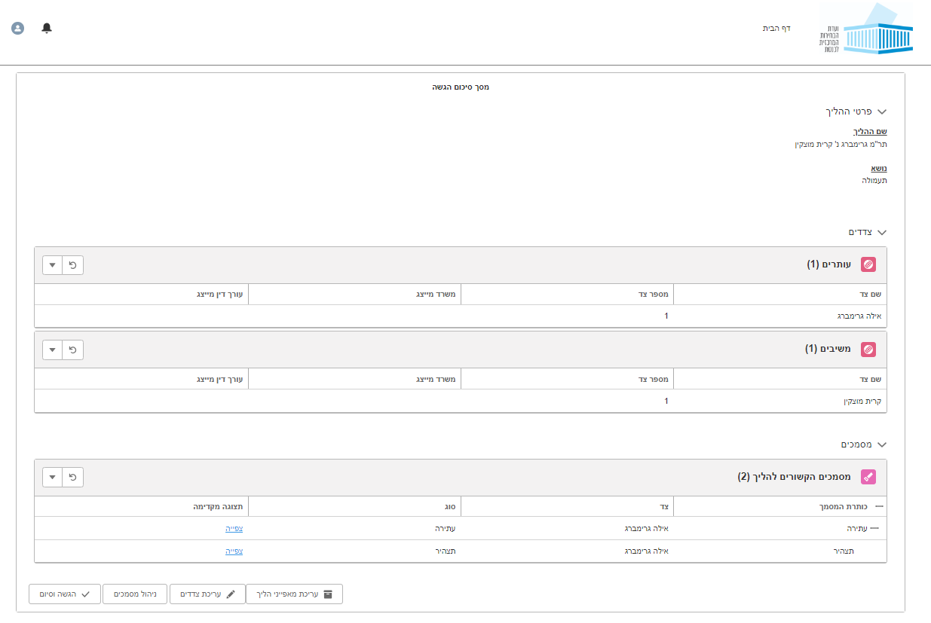
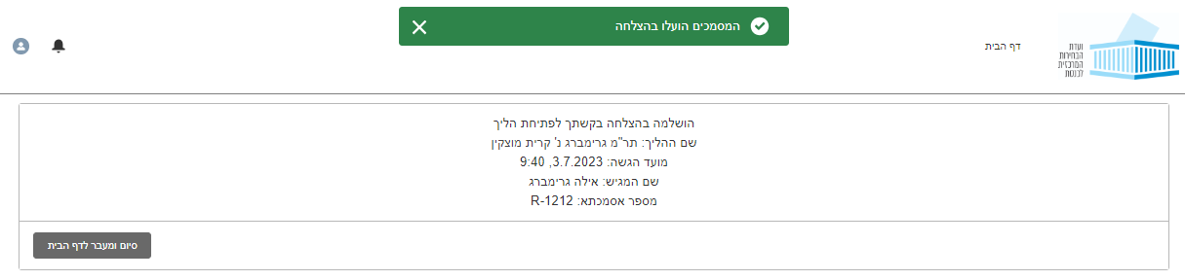
14
Filing a case – continued
4. Completing the Petitions process
The Completion screen contains all the information that has been entered regarding the case, allowing users to view all submitted details and documents. To view a document, press the “+” symbol. On this screen, users can edit or amend information, as well as add or remove documents. When the information is complete and correct, press the “הגשה וסיום” (Submit and End) button. After pressing the “הגשה וסיום“ (Submit and End) button, the system will confirm the Petitions. Confirmation will also be sent via email.

Slide 15
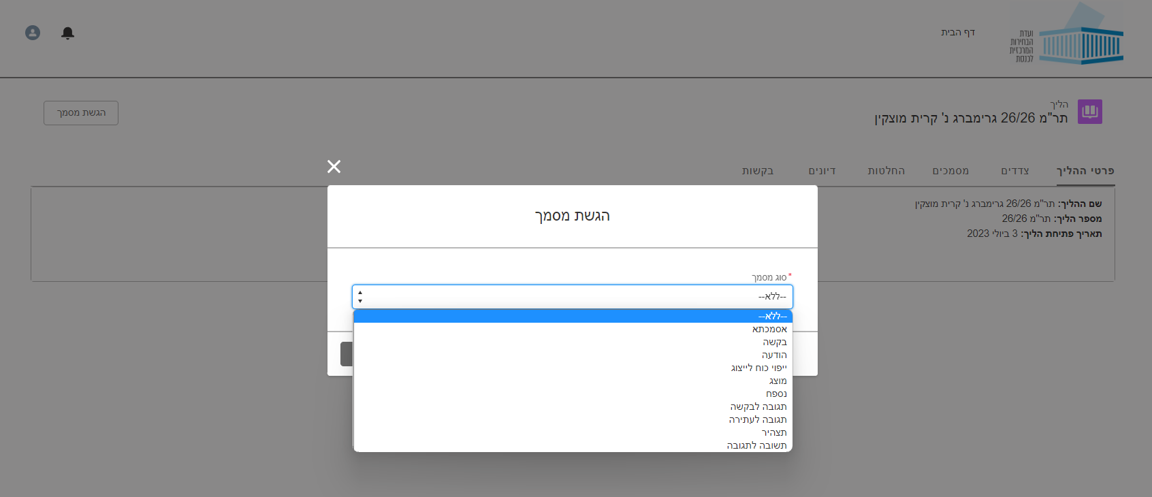
15
Chapter 2
Petitions a New Case and Submitting Documents
Submitting Documents for an Open Proceeding
Submitting Documents for an Open Case
Submitting Documents
At any stage, users may add documents to a proceeding to which they are party. Go to the Proceedings screen and press the “הגשת מסמך“ (Submit Document) button. Select the Document Type. Enter the document title and upload the file from your personal computer. Appendices may also be added.

Slide 16
16
Chapter 3
Actions for Legal Firms
Registering a Legal Firm in the System
Registering a Legal Firm in the System
Creating a Representative’s Account in the System
Any legal firm can open an account in the system. Registering is done by selecting the 'רישום משרד עו"ד’ (Register Legal Firm) button.

Slide 17
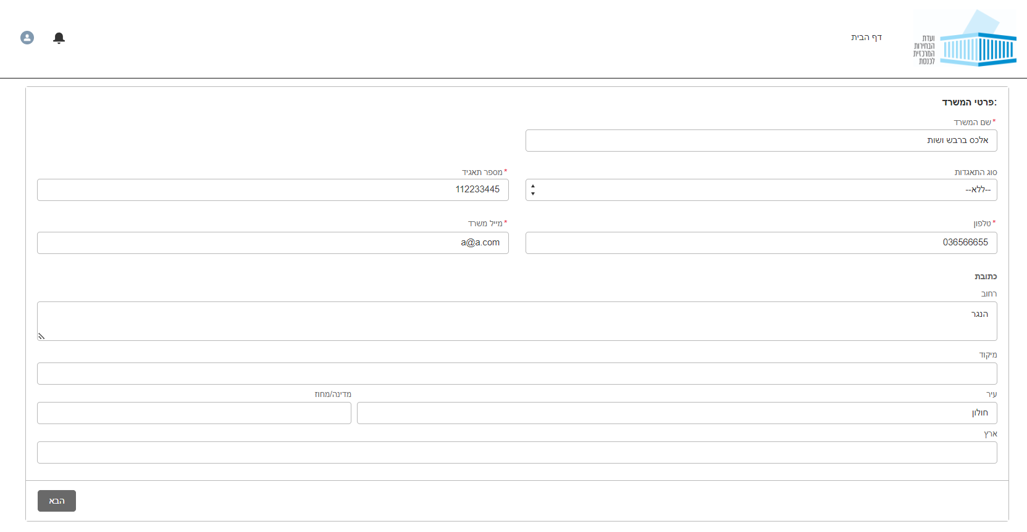
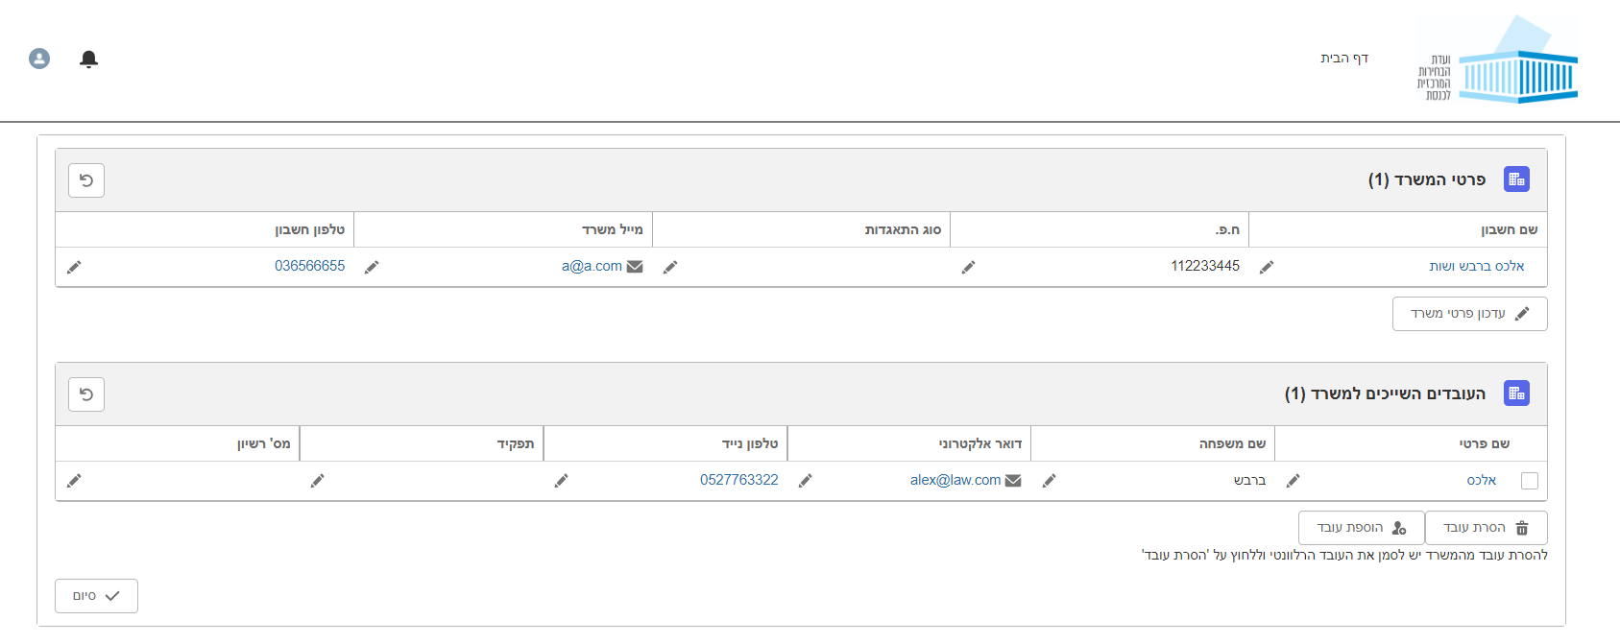
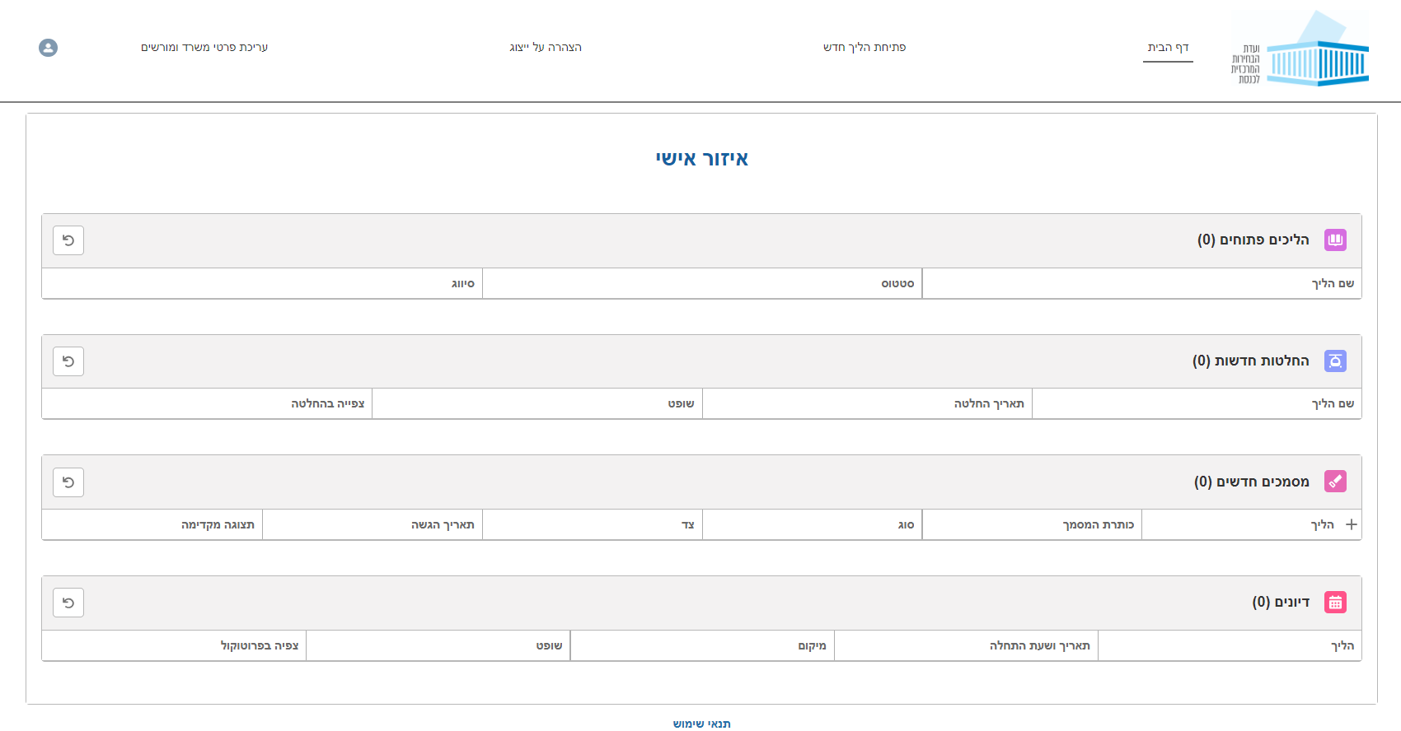
17
Chapter 3
Actions for Legal Firms
Registering a Legal Firm in the System
Registering a Legal Firm in the System – continued
Creating a representative’s account in the Petitions system
Enter the required information of the legal firm.
Next, you will be taken to a page to authorize members of the legal team. Persons marked as “מורשה עריכה” (authorized to edit) are allowed to edit the contact information and data of the legal firm as well as information regarding authorized personnel. You may add additional representatives of your firm as needed.
Editing Firm Information
Press the “עריכת פרטי משרד “ (Edit Firm Data) button to open an editing screen containing the firms’ information including the registered lawyers.

Slide 18
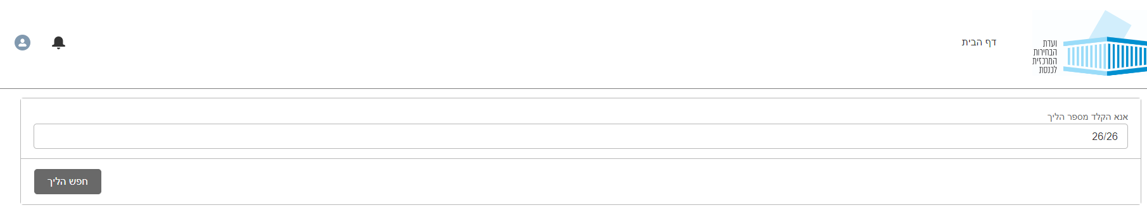
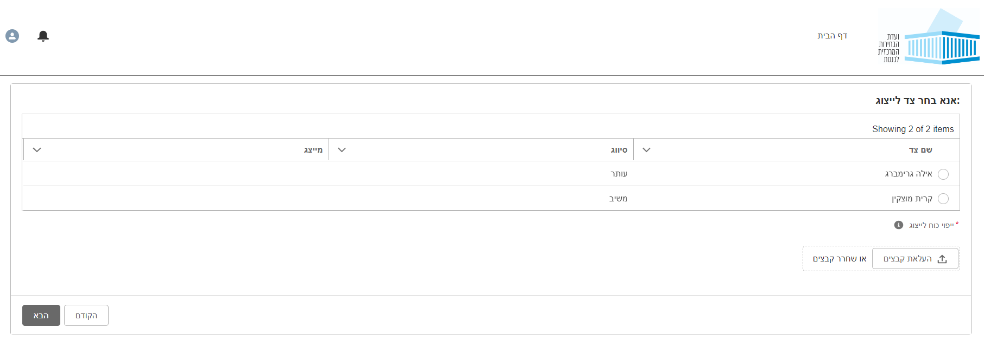
18
Chapter 3
Actions for Legal Firms
Declaration of Representative
Declaration of Representative
Declaration of Representative
After registering the firm, you can declare that the firm is representing a party to an existing proceeding by pressing 'הצהרה על ייצוג’ (Declaration of Representative).
Identify the correct proceeding.
Select the party your firm is representing, upload the Power of Attorney or Authorization for Representation letter and complete the process. From this point, all information and alerts regarding the proceeding will be accessible to you, and you may act on behalf of your client.

Slide 19
ניהול הליכים משפטיים במערכת עתירות
Conducting Proceedings Through the Electronic Petitions System
User Guide
[Party / Representative]
ועדת הבחירות | abra-it| 2023

