Slide 1

The Government’s Plan to Strengthen the North and Haifa
Education, Employment, Quality of Life and Community,
Populations with Special Needs
Coordinating Committee between the Government of Israel and the Jewish Agency, 2 Heshvan 5767, October 24, 2006
(First presented before the Israeli Cabinet for Strengthening the North and Haifa, 21 Elul 5766, September 14, 2006)

Slide 2
Goals of the Plan
Strengthening the education system in the northern communities
Indicator: Advancing and improving educational accomplishments.
Employment as a tool to narrow social gaps
Indicator: Increasing the number of employees and raising the rate of participation in the labor force.
Quality of life and community
Indicator: Adding to the population in the North
Treatment of the special needs population
Indicator: Strengthening these populations and reducing their dependency on allowance payments.

Slide 3
Implementation of Government Resolution
(No. 393 of August 20, 2006)
Additional Government Budget | Professional Task Force
525 | Government Activities Ms. Efrat Duvdevani
280 | Economic and Financial Tools Dr. Yossi Bachar
450 | Local Authorities Mr. Ram Belinkov
75 | Treatment of Special Needs Populations and Trauma Victims and Implementation of the Schmid Report Prof. Avi Yisraeli
240 | The Education System
1,570 | Total

Slide 4
Strengthening the North and Haifa*
Macro Data
The Plan for the North: Sources of Funding (in billions of NIS)
External Budget
Normal Budget
Added Budget
Total of: | Added Budget | Normal Budget | External Budgets
4,262.7 | 1,570 | 1,192.7^ | (1,350^^ + 150^^^) 1,500
Fields of Activity: education, employment, welfare, health, infrastructure, authorities and leisure.
* Including the Gaza Envelope communities and Ashkelon
^ New projects + acceleration of existing projects
^^ $300 million according to an exchange rate of 4.5
^^^ The Council for the Regularization of Sports Betting + Mifal HaPayis

Slide 5
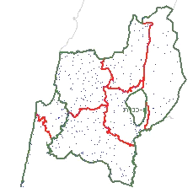
Content of the Resolution (North)
Definition: the area included in the boundary of the Northern District and Haifa Sub-District, according to the Ministry of Interior (6 sub-districts)
Sub-District Name | Sub-District Number | District
Safed | 21 | Northern
Kinneret | 22 | Northern
Jezreel | 23 | Northern
Acre | 24 | Northern
Golan | 29 | Northern
Haifa | 31 | Haifa
21
29
24
31
22
23
Map of the Northern District

Slide 6
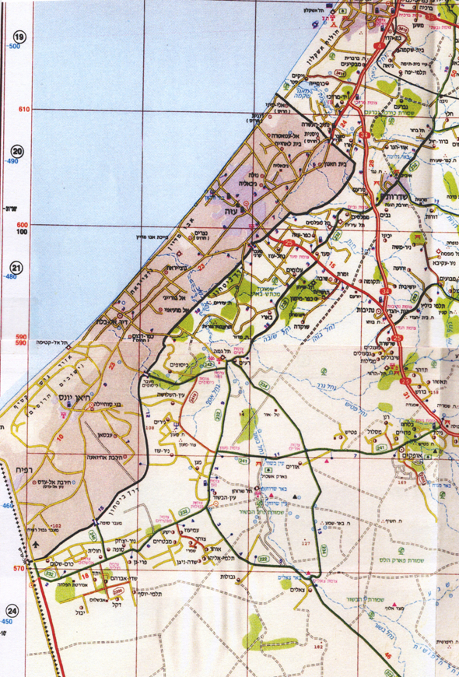
Content of the Resolution (South)
Sderot and 44 other communities
Located up to 7 km from the border
List of Communities:
Sderot ♦ Gvar’am, Zikim, Yad Mordechai, Carmiya, Nativ Ha’Asara ♦ Or HaNer, Ivim, Erez, Gevim, Yechini, Kfar Aza, Mifalsim, Nahal Oz, Nir Am ♦ Sa’ad, Alumim, Kfar Maimon, Zimrat, Shokda, Shuva, Toshia, Tkuma ♦ Avshalom Be’eri, Holit, Dekel, Y'vul, Yesha, Yated, Kissufim, Kerem Shalom, Mivtahim, Magen, Nir Yitzhak, Nir Oz, Nirim, Sufa, Ein HaBasor, Ein Hashlosha, Ami’Oz, Pri Gan, Ra’im, S'dei Avraham, Talme Yosef
Map of the Gaza Envelope Communities

Slide 7
Fields of Activity & Government Ministries
Education | Quality of Life and Community | Employment Encouragement | Special Needs Population | Government Ministry
 | +++ |  | +++ | Health
 | +++ |  |  | Housing
+ | ++ | +++ | ++ | Industry, Trade and Labor
 | ++ | ++ | ++ | Immigrant Absorption
 | +++ |  | +++ | Justice
 | +++ |  |  | Environmental Protection
++ | +++ |  |  | Science, Culture and Sport
 | +++ |  |  | Transportation

Slide 8
Fields of Activity & Government Ministries
Education | Quality of Life and Community | Employment Encouragement | Special Needs Population | Government Ministry
 | +++ |  |  | Infrastructure
 | ++ |  | +++ | Welfare
+++ | ++ |  | ++ | Education
 | ++ | +++ |  | Tourism
 |  | +++ |  | Agriculture
+ | +++ |  |  | Internal Security
 | +++ |  | +++ | Pensioners
+++ | +++ | +++ | +++ | Vice Prime Minister

Slide 9
Government Budgets in the Plan
(in NIS millions) **
Activities | Total | Addition | Existing Budget | Government Office
Employment track, capital grants, small businesses, anchoring plant in the employment track, industrial areas, exporters, employment in hotels and construction, day care centers, scholarships, professional training | 363 | 184 | 234 | Industry, Trade and Labor
Employment and welfare for new immigrants and treating the special needs population | 12.4 | 8.2 | 4.2 | Immigrant Absorption
Infrastructure, grants for producers | 98.2 | 46.2 | 52 | Agriculture and Rural Development
** including the Gaza Envelope and Ashkelon

Slide 10
Government Budgets in the Plan
(in NIS millions) **
Activities | Total | Addition | Existing Budget | Government Office
Marketing + infrastructure (including 30 to Ashkelon) | 124 | 82 | 42 | Tourism
“Lighting Up the North” – events to attract internal and foreign tourism | 15 | 15 |  | Events
Grants for sewage in accordance with the plan – the existing budget includes an additional NIS 50 million which will be allocated by the Ministry of Finance | 170 | 50 | 120 | Infrastructure
Urban roads | 145 | 45 | 100 | Transportation
** including the Gaza Envelope and Ashkelon

Slide 11
Government Budgets in the Plan
(in NIS millions) **
Activities | Total | Addition | Existing Budget | Government Office
Infrastructure, tourism, employment, agriculture and initiatives | 36 | 30 | 6 | The Department for Settlement
Rehabilitating neighborhoods, public buildings | 136 | 55 | 81 | Housing
Special needs population + construction + intensive care ambulance | 162 | 69.9 | 92 | Health
** including the Gaza Envelope and Ashkelon

Slide 12
Government Budgets in the Plan
(in NIS millions) **
Activities | Total | Addition | Existing Budget | Government Office
Rehabilitating streams, the Kinneret, waste treatment | 51.5 | 39 | 12.5 | Environmental Protection
Encouraging the creative arts, sports and science in the North | 79.3 | 15 | 64.3 | Science, Culture and Sport
Development of services for the community | 43.7 | 20 | 23.7 | Welfare
In addition, donations in the scope of NIS 340 million | 324 | 244.3 | 80 | Education
** including the Gaza Envelope and Ashkelon

Slide 13
Government Budgets in the Plan
(in NIS millions) **
Activities | Total | Addition | Existing Budget | Government Office
Operating the “Violence-Free City” plan in 54 cities in the North | 25 |  | 25 | Internal Security
Strengthening local authorities | 650 | 450 | 200 | Interior
Legal assistance | 30.8 | 4.8 | 26 | Justice
Including treatment for special needs populations | 20 | 20 |  | Pensioners
** including the Gaza Envelope and Ashkelon

Slide 14
Government Budgets in the Plan
(in NIS millions) **
Activities | Total | Addition | Existing Budget | Government Office
Plan to treat the special needs population | 2.6 | 2.6 |  | National Insurance Institute
Various projects | 75 | 45 | 30 | Vice Prime Minister
Schmidt Report (NIS 40 million), Haifa Plan (NIS 90 million), internal and publicity (NIS 14 million) | 144 | 144 |  | Prime Minister
 | 2,762 | 1,570 | 1,192 | Total
** כולל עוטף עזה ואשקלון

Slide 15
Plan for the Treatment of the Population with Special Needs and Trauma Victims
Total Budget of the Office | 2007 Budget in NIS millions | 2006 Budget in NIS millions | Government Office
17.96 | 10.40 | 7.56 | Ministry of Health
4.32 | 2.32 | 2.00 | Ministry of Education
0.30 | 0.15 | 0.15 | Ministry of Immigrant Absorption
6.90 | 4.90 | 2.00 | Ministry of Pensioner Affairs
2.60 | 1.60 | 1.00 | National Insurance Institute
32.08 | 19.37 | 12.71 | Total annual budget in NIS million

Slide 16
Gaza Envelope Communities and Ashkelon
Assistance for the Gaza Envelope Regional Council
allocation of NIS 4.5 million to finance the expenses resulting from the security situation in the Gaza Envelope Council during 2006
Strategic Plan for the Development of Tourism
allocation of NIS 30 million to strengthen and advance tourism in Ashkelon
Property Tax
discount of 25% for 2007: for industry, government offices, services, trade and crafts, agriculture and homes in Sderot and the Gaza Envelope communities

Slide 17
Haifa
Plan for Economic Development in the Scope of No Less Than NIS 90 Million:
Encouraging employment
Industry
Tourism

Slide 18
Coordination of Follow-Up and Oversight
Formulating a Community-Based Plan
under the responsibility of the Director General of the Vice Prime Minister’s Office
Oversight of the Plan by Steering Committee
Follow-Up and Oversight
by the Prime Minister’s Office Department for Policy Implementation
Quarterly Reports
to the Cabinet for the North and Haifa

Slide 19
Timetable
14/8
20/8
23/8
27/8
29/8
3/9
12/9
14/9
Cease fire
Government Resolution
to strengthen
the North and Haifa
Cabinet
Meeting
Ministerial discussion
regarding emergency
preparedness
Cabinet
Meeting
Opening of
the school
year
Government discussion
on the
State Budget
Government discussion
on the budget
for the North
October
November
December
January
February
March
April
May
June
July
From the end of the holidays through the first half of December 2006 – under the responsibility of the Director General of the Vice Prime Minister’s Office and in coordination with the Prime Minister’s Office and the Steering Committee, approval of the detailed plan for each community:
  In accordance with the size of the community
  In accordance with the level of need for immediate intervention

Slide 20
Timetable
14/8
20/8
23/8
27/8
29/8
3/9
12/9
14/9
Cease fire
Government Resolution
to strengthen
the North and Haifa
Cabinet
Meeting
Ministerial discussion
regarding emergency
preparedness
Cabinet
Meeting
Opening of
the school
year
Government discussion
on the
State Budget
Government discussion
on the budget
for the North
October
November
December
January
February
March
April
May
June
July
From December 2006 and Beyond – meeting of the Cabinet once per quarter to follow-up on and oversee progress
In the first half of 2007 – the plan for the Strengthening of the North and Haifa for 2008-2010 will be brought before the Cabinet for its approval

Slide 21
The Government’s Plan to Strengthen the North and Haifa
Education, Employment, Quality of Life and Community,
Populations with Special Needs
Coordinating Committee between the Government of Israel and the Jewish Agency, 2 Heshvan 5767, October 24, 2006
(First presented before the Israeli Cabinet for Strengthening the North and Haifa, 21 Elul 5766, September 14, 2006)

